Slide 1

Progress Report
Simulasi Unit Commitment
Oleh:
Muhammad Aris Risnandar
NIM: 25/571656/STK/01375
Program Studi Doktor Teknik Elektro
Departemen Teknik Elektro dan Teknologi Informasi
Universitas Gadjah Mada
23 Juni 2026

Slide 2
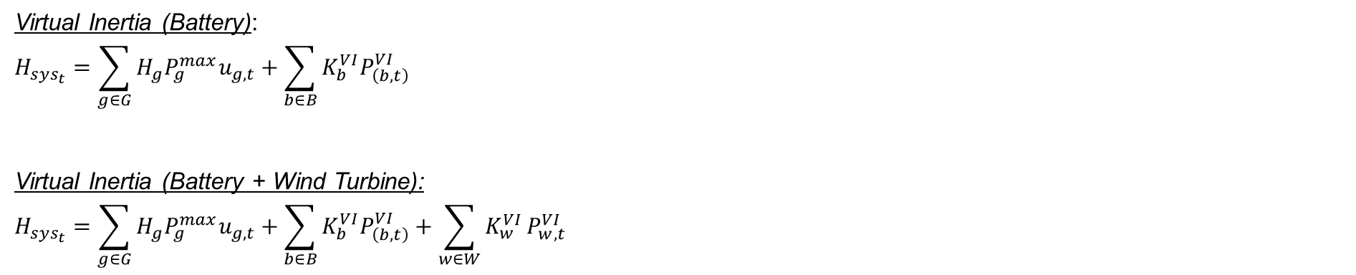
Latar Belakang
Dominasi pembangkit EBT berbasis inverter menurunkan inersia system.
Inersia rendah mengakibatkan RoCoF tinggi saat terjadi gangguan.
Virtual inersia (VI) meredam penurunan frekuensi dengan cara meniru perilaku Generator Sinkron (SG).
Jenis VI:
Virtual Synchronous Machine (VSM)
Berperilaku sebagai sumber tegangan ideal. Beroperasi mirip SG konvensional (mengendalikan frekuensi dan tegangan).
Virtual Synchronous Generator (VSG)
Berperilaku sebagai sumber arus ideal. Pembangkitan daya (P dan Q) cenderung tetap akibat variasi frekuensi dan tegangan.
Virtual Inertia (Battery):
$$H_{sys_{t}}=\sum_{g∈G}{H_{g}P_{g}^{max}u_{g,t}}+\sum_{b∈B}{K_{b}^{VI}P_{\left(b,t\right)}^{VI}}$$
Virtual Inertia (Battery + Wind Turbine):
$$H_{sys_{t}}=\sum_{g∈G}{H_{g}P_{g}^{max}u_{g,t}}+\sum_{b∈B}{K_{b}^{VI}P_{\left(b,t\right)}^{VI}}+\sum_{w∈W}{K_{w}^{VI}}P_{w,t}^{VI}$$

Slide 3

Latar Belakang
Respon Inersia Baterai:
$$IR_{e,t,s}=syn{_i}_{e,t}\frac{f^{0}}{2} {\left(\frac{df}{dt}\right)}^{−1}$$
$IR_{e,t,s}$ = respon inersia dari ESS $e$ pada waktu $t$ (MWs/Hz)
$syn_i_{e,t}$ = output control inersia sintetis dari baterai (pu)
$f_{0}$ = frekuensi nominal system (Hz)
$df/dt$ = laju perubahan frekuensi (RoCoF)
Total Daya Respon Frekuensi Baterai:
$$FR_{e,t}=S_{e}^{b}\left(pfr_{e,t}+syn{_i}_{e,t}\right)$$
$$\left|FR_{e,t}\right|≤S_{e}^{b}$$
$FR_{e,t}$ = total daya respons frekuensi dari baterai
$pfr_{e,t}$ = kontribusi PFR dari baterai (pu)
$S_{e}^{b}$ = daya maksimal baterai (MW)

Slide 4
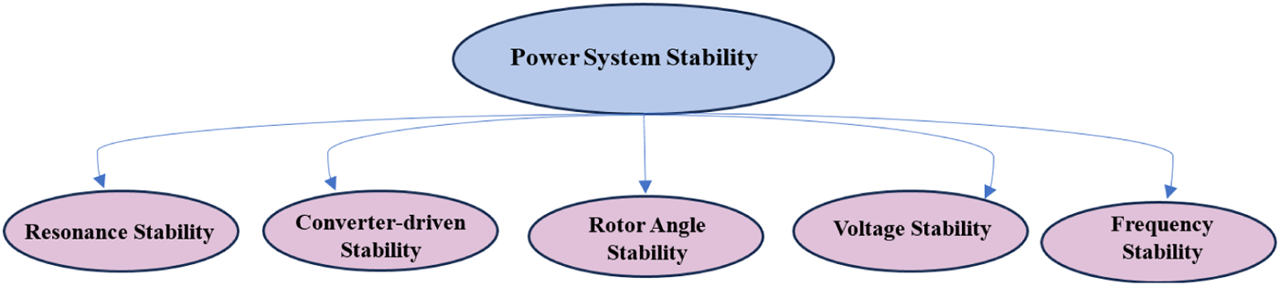
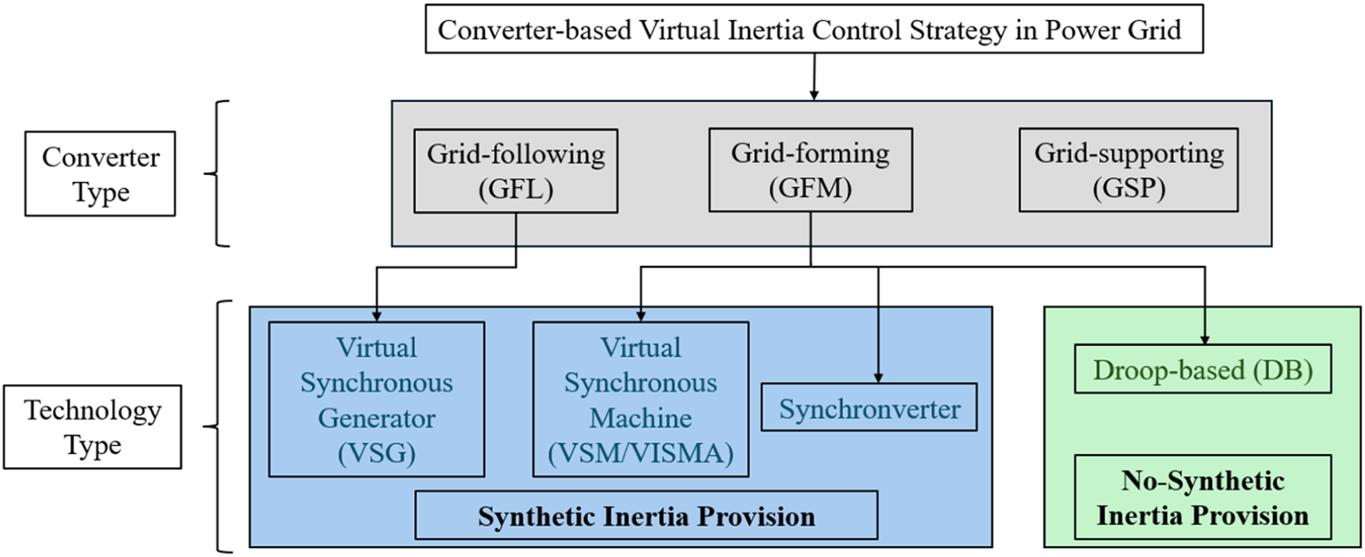
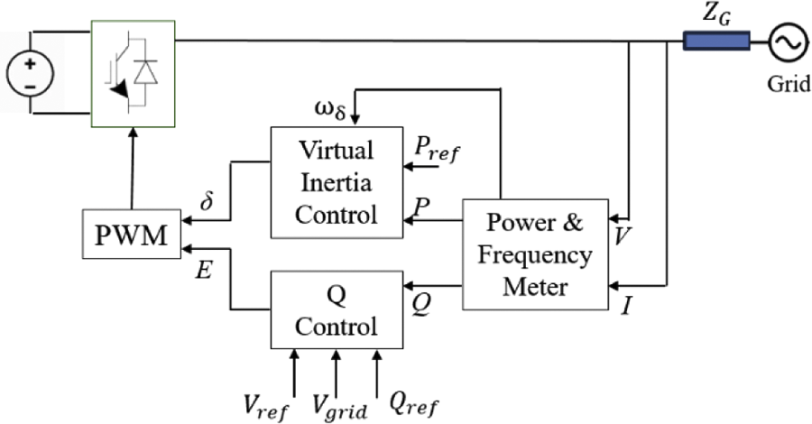
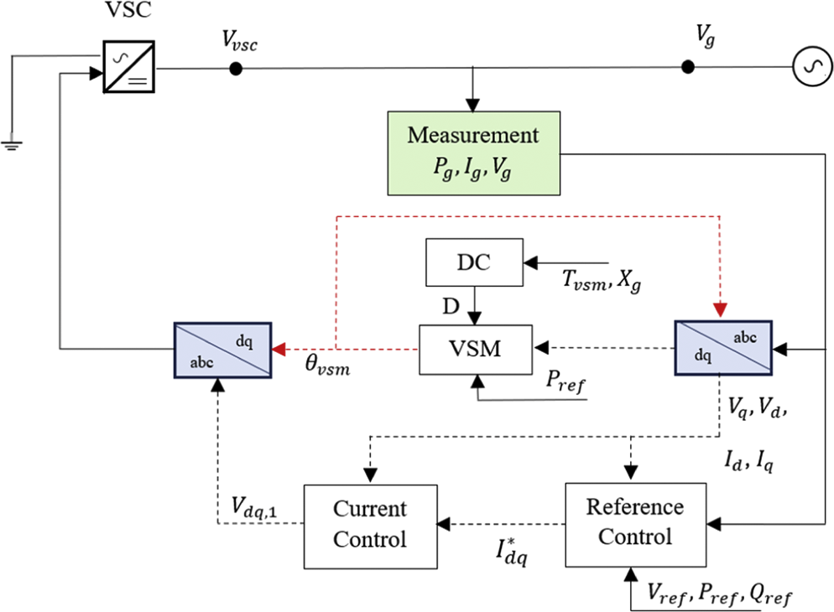
Fungsi Objektif (Minimum Total Cost)
VSG Block Control Modeling
VSM Block Control Modeling

Slide 5
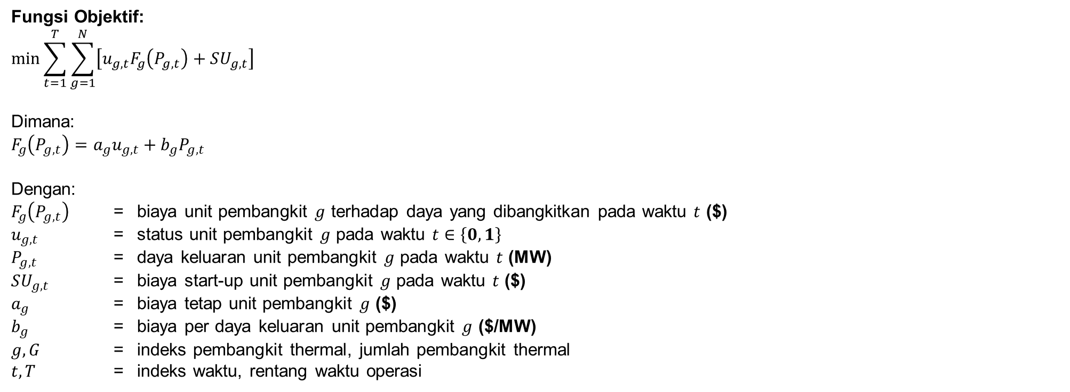
Fungsi Objektif (Minimum Total Cost)
Fungsi Objektif:
$$\min{\sum_{t=1}^{T}{\sum_{g=1}^{N}{\left[u_{g,t}F_{g}\left(P_{g,t}\right)+SU_{g,t}\right]}}}$$
Dimana:
$$F_{g}\left(P_{g,t}\right)=a_{g}u_{g,t}+b_{g}P_{g,t}$$
Dengan:
$F_{g}\left(P_{g,t}\right)$ = biaya unit pembangkit $g$ terhadap daya yang dibangkitkan pada waktu $t$ ($)
$u_{g,t}$ = status unit pembangkit $g$ pada waktu $t$ $∈\left\{0,1\right\}$
$P_{g,t}$ = daya keluaran unit pembangkit $g$ pada waktu $t$ (MW)
$SU_{g,t}$ = biaya start-up unit pembangkit $g$ pada waktu $t$ ($)
$a_{g}$ = biaya tetap unit pembangkit $g$ ($)
$b_{g}$ = biaya per daya keluaran unit pembangkit $g$ ($/MW)
$g, G$ = indeks pembangkit thermal, jumlah pembangkit thermal
$t,T$ = indeks waktu, rentang waktu operasi

Slide 6
Constraint
Constraint | Fungsi dalam Simulasi | Simulasi ke (#)
 |  | 1 | 2 | 3 | 4 | 5 | 6 | 7
use_initial_condition | Menetapkan kondisi awal sistem (status ON/OFF, output daya, dan riwayat operasi unit) sebagai titik awal optimasi | V | V | V | V | V | V | V
con_startup_shutdown_logic | Menentukan hubungan status ON/OFF dengan proses startup dan shutdown | V | V | V | V | V | V | V
con_power_balance | Menjamin total daya pembangkit memenuhi kebutuhan beban setiap interval waktu | V | V | V | V | V | V | V
con_capacity_upper | Membatasi output generator tidak melebihi kapasitas maksimum | V | V | V | V | V | V | V
con_capacity_lower | Menjamin generator yang beroperasi memenuhi batas minimum teknis | V | V | V | V | V | V | V
con_minimum_up_time | Mencegah generator dimatikan sebelum memenuhi waktu operasi minimum | V | V | V | V | V | V | V
con_minimum_down_time | Mencegah generator dinyalakan kembali sebelum memenuhi waktu padam minimum | V | V | V | V | V | V | V
con_ramp_up | Membatasi kenaikan output generator antar interval waktu | V | V | V | V | V | V | V
con_ramp_down | Membatasi penurunan output generator antar interval waktu | V | V | V | V | V | V | V
con_n1_spinning_reserve | Menjamin reserve cukup untuk mengantisipasi kehilangan pembangkit terbesar | V | V | V | V | V | V | V
con_battery | Membatasi operasi charge-discharge dan State of Charge (SOC) baterai |  | V | V |  | V | V | V
con_wt | Membatasi operasi ketersediaan, penggunaan dan curtailment PLTB. |  |  | V |  |  | V | V
con_min_inertia | Membatasi minimum inersia system berdasarkan Batasan RoCoF |  |  |  | V | V | V | V
con_battery_vi | Menambahkan kontribusi virtual inersia dari baterai |  |  |  |  |  |  | V
con_wt_vi | Menambahkan kontribusi virtual inersia dari PLTB |  |  |  |  |  |  | V

Slide 7
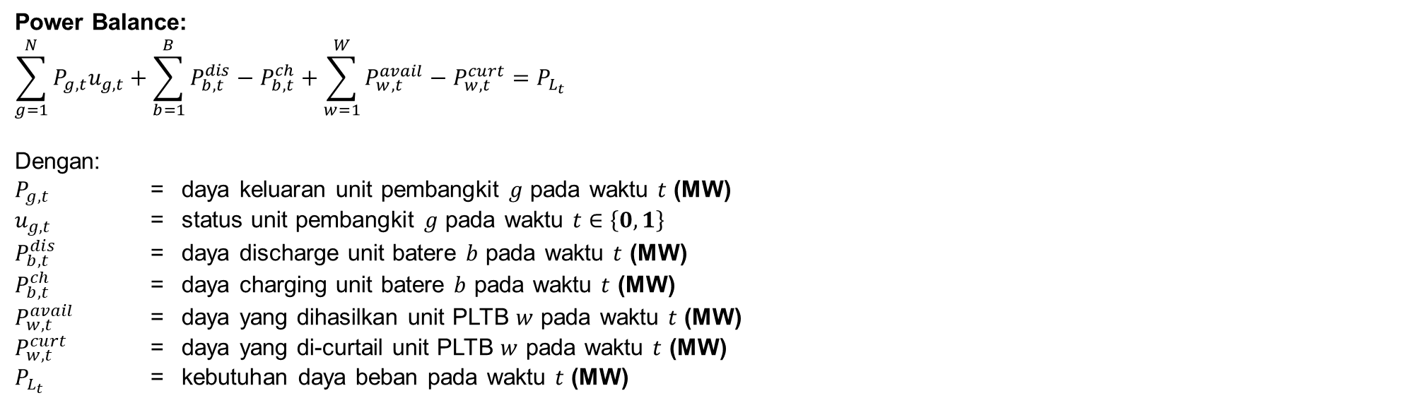
Formulasi Constraint (1)
Power Balance:
$$\sum_{g=1}^{N}{P_{g,t}u_{g,t}}+\sum_{b=1}^{B}{P_{b,t}^{dis}−P_{b,t}^{ch}}+\sum_{w=1}^{W}{P_{w,t}^{avail}−P_{w,t}^{curt}}=P_{L_{t}}$$
Dengan:
$P_{g,t}$ = daya keluaran unit pembangkit $g$ pada waktu $t$ (MW)
$u_{g,t}$ = status unit pembangkit $g$ pada waktu $t$ $∈\left\{0,1\right\}$
$P_{b,t}^{dis}$ = daya discharge unit batere $b$ pada waktu $t$ (MW)
$P_{b,t}^{ch}$ = daya charging unit batere $b$ pada waktu $t$ (MW)
$P_{w,t}^{avail}$ = daya yang dihasilkan unit PLTB $w$ pada waktu $t$ (MW)
$P_{w,t}^{curt}$ = daya yang di-curtail unit PLTB $w$ pada waktu $t$ (MW)
$P_{L_{t}}$ = kebutuhan daya beban pada waktu $t$ (MW)

Slide 8
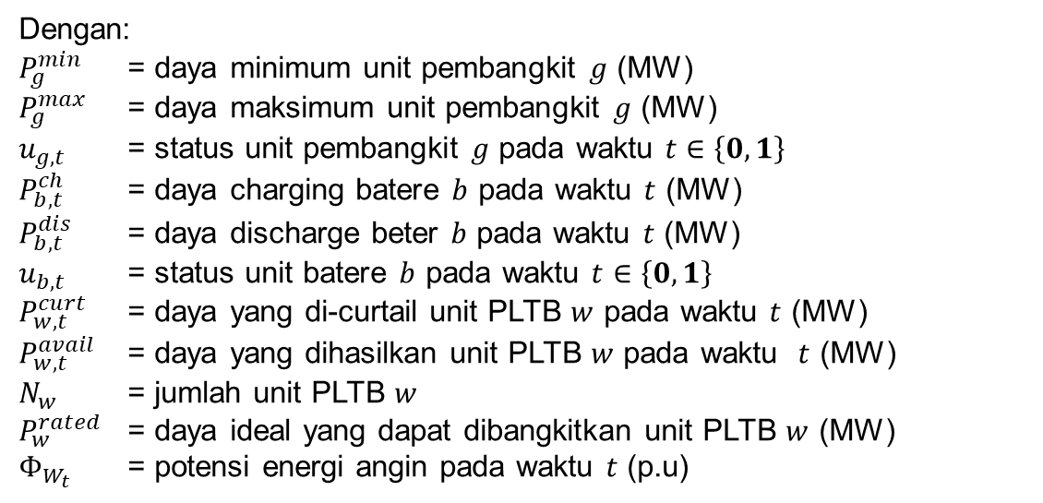
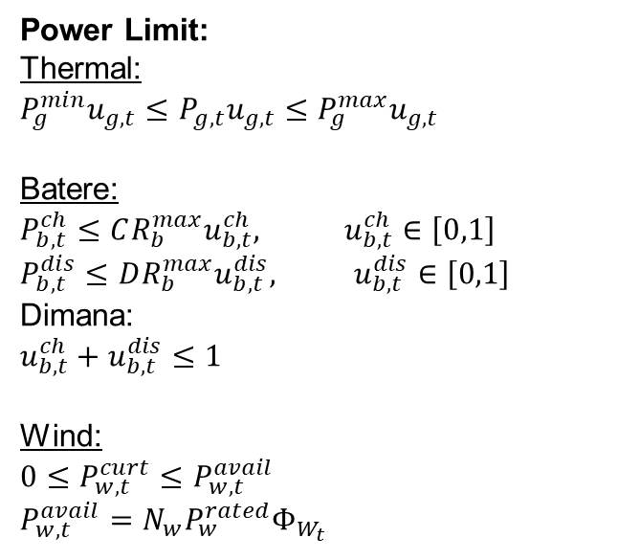
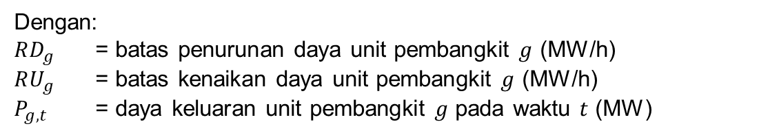

Formulasi Constraint (2)
Power Limit:
Thermal:
$$P_{g}^{min}u_{g,t}≤P_{g,t}u_{g,t}≤P_{g}^{max}u_{g,t}$$
Batere:
$$P_{b,t}^{ch}≤{CR_{b}^{max}u}_{b,t}^{ch}, u_{b,t}^{ch}∈\left[0,1\right]$$
$$P_{b,t}^{dis}≤DR_{b}^{max}u_{b,t}^{dis}, u_{b,t}^{dis}∈\left[0,1\right]$$
Dimana:
$$u_{b,t}^{ch}+u_{b,t}^{dis}≤1$$
Wind:
$$0≤P_{w,t}^{curt}≤P_{w,t}^{avail}$$
$$P_{w,t}^{avail}=N_{w}P_{w}^{rated}Φ_{W_{t}}$$
Dengan:
$P_{g}^{min}$ = daya minimum unit pembangkit $g$ (MW)
$P_{g}^{max}$ = daya maksimum unit pembangkit $g$ (MW)
$u_{g,t}$ = status unit pembangkit $g$ pada waktu $t$ $∈\left\{0,1\right\}$
$P_{b,t}^{ch}$ = daya charging batere $b$ pada waktu $t$ (MW)
$P_{b,t}^{dis}$ = daya discharge beter $b$ pada waktu $t$ (MW)
$u_{b,t}$ = status unit batere $b$ pada waktu $t$ $∈\left\{0,1\right\}$
$P_{w,t}^{curt}$ = daya yang di-curtail unit PLTB $w$ pada waktu $t$ (MW)
$P_{w,t}^{avail}$ = daya yang dihasilkan unit PLTB $w$ pada waktu $t$ (MW)
$N_{w}$ = jumlah unit PLTB $w$
$P_{w}^{rated}$ = daya ideal yang dapat dibangkitkan unit PLTB $w$ (MW)
$Φ_{W_{t}}$ = potensi energi angin pada waktu $t$ (p.u)
Ramp Up/Down:
$$−RD_{g}≤P_{g,t}−P_{g,t−1}≤RU_{g}$$
Dengan:
$RD_{g}$ = batas penurunan daya unit pembangkit $g$ (MW/h)
$RU_{g}$ = batas kenaikan daya unit pembangkit $g$ (MW/h)
$P_{g,t}$ = daya keluaran unit pembangkit $g$ pada waktu $t$ (MW)

Slide 9
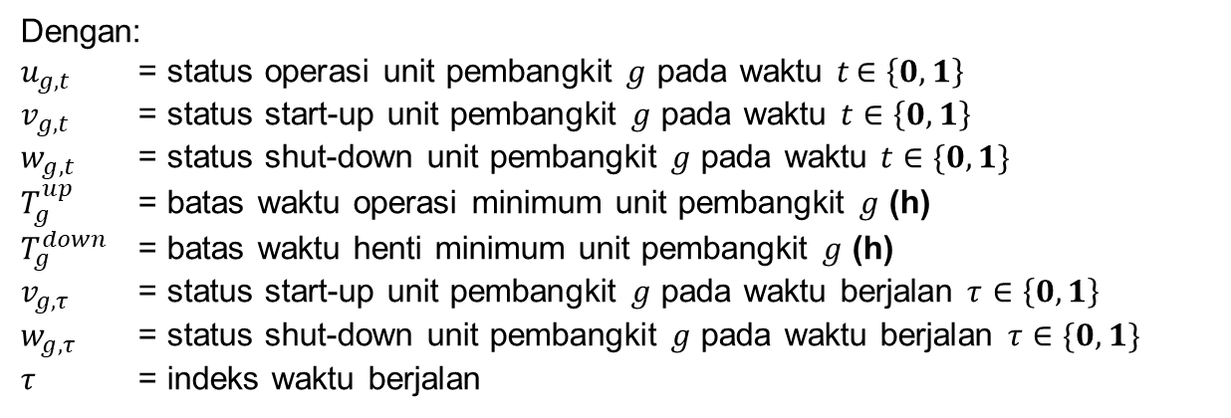
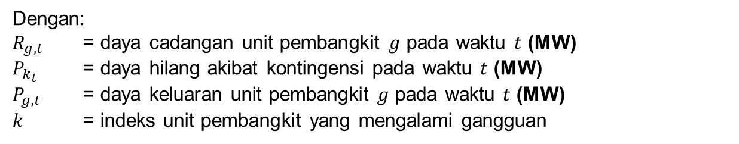
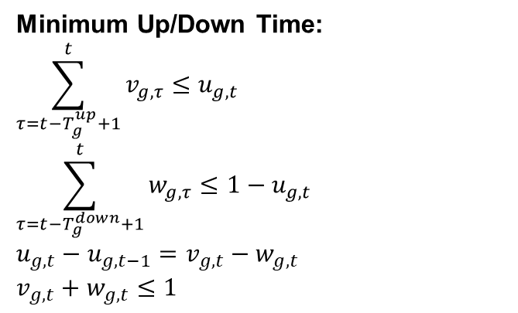
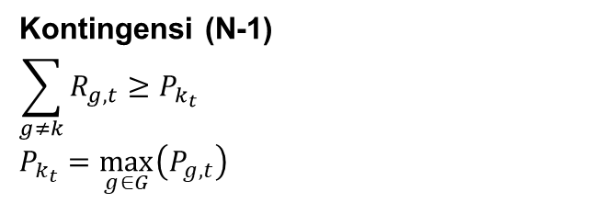
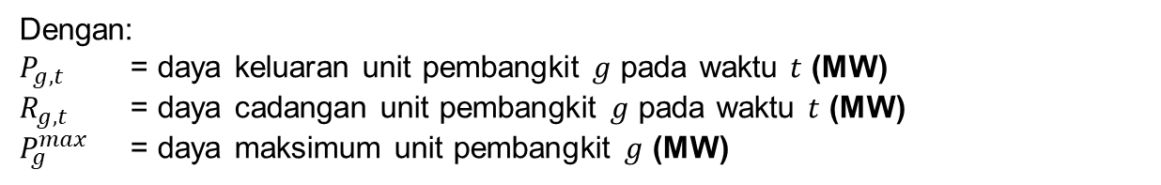
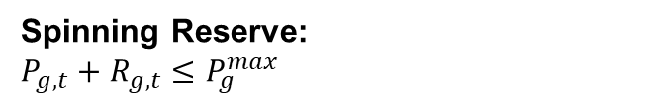
Formulasi Constraint (3)
Minimum Up/Down Time:
$$\sum_{τ=t−T_{g}^{up}+1}^{t}{v_{g,τ}}≤u_{g,t}$$
$$\sum_{τ=t−T_{g}^{down}+1}^{t}{w_{g,τ}}≤1−u_{g,t}$$
$$u_{g,t}−u_{g,t−1}=v_{g,t}−w_{g,t}$$
$$v_{g,t}+w_{g,t}≤1$$
Dengan:
$u_{g,t}$ = status operasi unit pembangkit $g$ pada waktu $t$ $∈\left\{0,1\right\}$
$v_{g,t}$ = status start-up unit pembangkit $g$ pada waktu $t$ $∈\left\{0,1\right\}$
$w_{g,t}$ = status shut-down unit pembangkit $g$ pada waktu $t$ $∈\{0,1\}$
$T_{g}^{up}$ = batas waktu operasi minimum unit pembangkit $g$ (h)
$T_{g}^{down}$ = batas waktu henti minimum unit pembangkit $g$ (h)
$v_{g,τ}$ = status start-up unit pembangkit $g$ pada waktu berjalan $τ$ $∈\left\{0,1\right\}$
$w_{g,τ}$ = status shut-down unit pembangkit $g$ pada waktu berjalan $τ$ $∈\{0,1\}$
$τ$ = indeks waktu berjalan
Spinning Reserve:
$$P_{g,t}+R_{g,t}≤P_{g}^{max}$$
Dengan:
$P_{g,t}$ = daya keluaran unit pembangkit $g$ pada waktu $t$ (MW)
$R_{g,t}$ = daya cadangan unit pembangkit $g$ pada waktu $t$ (MW)
$P_{g}^{max}$ = daya maksimum unit pembangkit $g$ (MW)
Kontingensi (N-1)
$$\sum_{g≠k}{R_{g,t}}≥P_{k_{t}}$$
$$P_{k_{t}}=\max_{g∈G}\left(P_{g,t}\right)$$
Dengan:
$R_{g,t}$ = daya cadangan unit pembangkit $g$ pada waktu $t$ (MW)
$P_{k_{t}}$ = daya hilang akibat kontingensi pada waktu $t$ (MW)
$P_{g,t}$ = daya keluaran unit pembangkit $g$ pada waktu $t$ (MW)
$k$ = indeks unit pembangkit yang mengalami gangguan

Slide 10
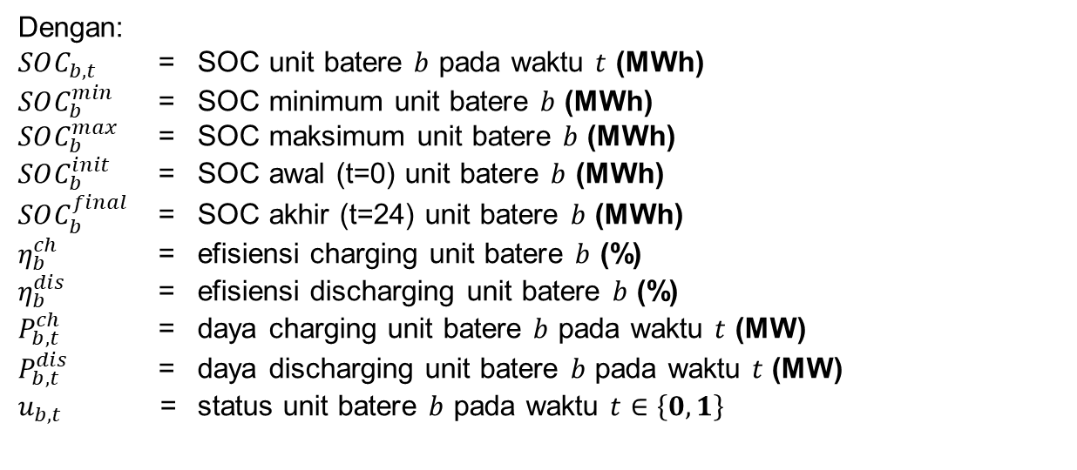
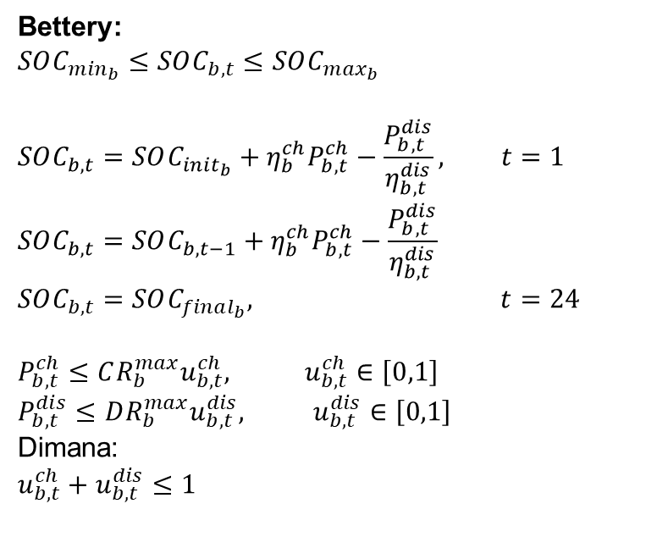
Formulasi Constraint (4)
Bettery:
$$SOC_{m{in}_{b}}≤SOC_{b,t}≤SOC_{m{ax}_{b}}$$
$$SOC_{b,t}=SOC_{init_{b}}+η_{b}^{ch}P_{b,t}^{ch}−\frac{P_{b,t}^{dis}}{η_{b,t}^{dis}}, t=1$$
$$SOC_{b,t}=SOC_{b,t−1}+η_{b}^{ch}P_{b,t}^{ch}−\frac{P_{b,t}^{dis}}{η_{b,t}^{dis}}$$
$$SOC_{b,t}=SOC_{final_{b}}, t=24$$
$$P_{b,t}^{ch}≤{CR_{b}^{max}u}_{b,t}^{ch}, u_{b,t}^{ch}∈\left[0,1\right]$$
$$P_{b,t}^{dis}≤DR_{b}^{max}u_{b,t}^{dis}, u_{b,t}^{dis}∈\left[0,1\right]$$
Dimana:
$$u_{b,t}^{ch}+u_{b,t}^{dis}≤1$$
Dengan:
$SOC_{b,t}$ = SOC unit batere $b$ pada waktu $t$ (MWh)
$SOC_{b}^{min}$ = SOC minimum unit batere $b$ (MWh)
$SOC_{b}^{max}$ = SOC maksimum unit batere $b$ (MWh)
$SOC_{b}^{init}$ = SOC awal (t=0) unit batere $b$ (MWh)
$SOC_{b}^{final}$ = SOC akhir (t=24) unit batere $b$ (MWh)
$η_{b}^{ch}$ = efisiensi charging unit batere $b$ (%)
$η_{b}^{dis}$ = efisiensi discharging unit batere $b$ (%)
$P_{b,t}^{ch}$ = daya charging unit batere $b$ pada waktu $t$ (MW)
$P_{b,t}^{dis}$ = daya discharging unit batere $b$ pada waktu $t$ (MW)
$u_{b,t}$ = status unit batere $b$ pada waktu $t$ $∈\left\{0,1\right\}$

Slide 11
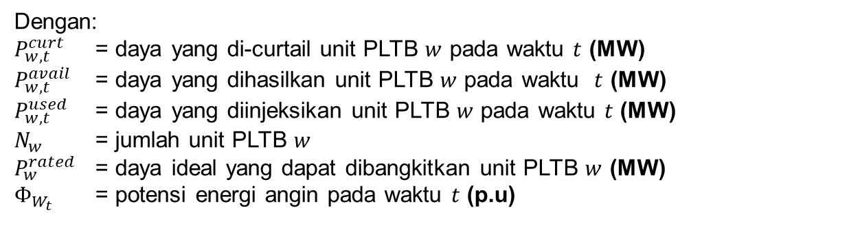

Formulasi Constraint (5)
Wind Turbine:
$$0≤P_{w,t}^{curt}≤P_{w,t}^{avail}$$
$$P_{w,t}^{avail}=N_{w}P_{w}^{rated}Φ_{W_{t}}$$
$$P_{w,t}^{used}=P_{w,t}^{avail}−P_{w,t}^{curt}$$
Dengan:
$P_{w,t}^{curt}$ = daya yang di-curtail unit PLTB $w$ pada waktu $t$ (MW)
$P_{w,t}^{avail}$ = daya yang dihasilkan unit PLTB $w$ pada waktu $t$ (MW)
$P_{w,t}^{used}$ = daya yang diinjeksikan unit PLTB $w$ pada waktu $t$ (MW)
$N_{w}$ = jumlah unit PLTB $w$
$P_{w}^{rated}$ = daya ideal yang dapat dibangkitkan unit PLTB $w$ (MW)
$Φ_{W_{t}}$ = potensi energi angin pada waktu $t$ (p.u)

Slide 12
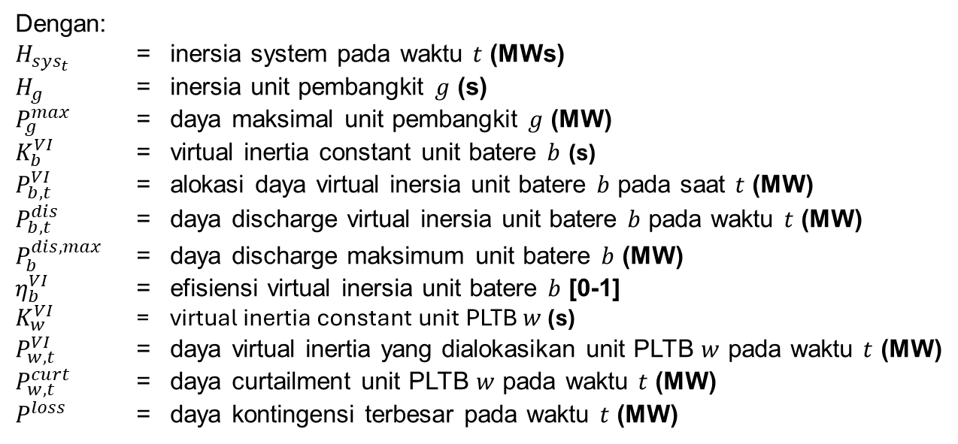
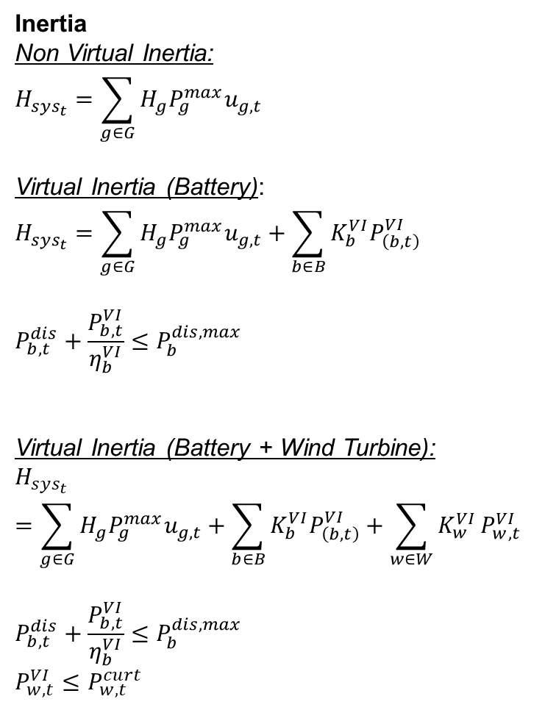
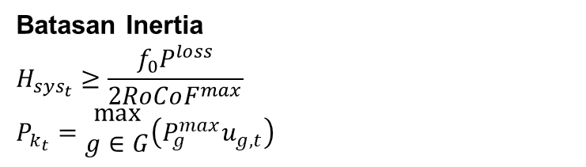
Formulasi Constraint (6)
Inertia
Non Virtual Inertia:
$$H_{sys_{t}}=\sum_{g∈G}{H_{g}P_{g}^{max}u_{g,t}}$$
Virtual Inertia (Battery):
$$H_{sys_{t}}=\sum_{g∈G}{H_{g}P_{g}^{max}u_{g,t}}+\sum_{b∈B}{K_{b}^{VI}P_{\left(b,t\right)}^{VI}}$$
$$P_{b,t}^{dis}+\frac{P_{b,t}^{VI}}{η_{b}^{VI}}≤P_{b}^{dis,max}$$
Virtual Inertia (Battery + Wind Turbine):
$$H_{sys_{t}}=\sum_{g∈G}{H_{g}P_{g}^{max}u_{g,t}}+\sum_{b∈B}{K_{b}^{VI}P_{\left(b,t\right)}^{VI}}+\sum_{w∈W}{K_{w}^{VI}}P_{w,t}^{VI}$$
$$P_{b,t}^{dis}+\frac{P_{b,t}^{VI}}{η_{b}^{VI}}≤P_{b}^{dis,max}$$
$$P_{w,t}^{VI}≤P_{w,t}^{curt}$$
Dengan:
$H_{sys_{t}}$ = inersia system pada waktu $t$ (MWs)
$H_{g}$ = inersia unit pembangkit $g$ (s)
$P_{g}^{max}$ = daya maksimal unit pembangkit $g$ (MW)
$K_{b}^{VI}$ = virtual inertia constant unit batere $b$ (s)
$P_{b,t}^{VI}$ = alokasi daya virtual inersia unit batere $b$ pada saat $t$ (MW)
$P_{b,t}^{dis}$ = daya discharge virtual inersia unit batere $b$ pada waktu $t$ (MW)
$P_{b}^{dis,max}$ = daya discharge maksimum unit batere $b$ (MW)
$η_{b}^{VI}$ = efisiensi virtual inersia unit batere $b$ [0-1]
$K_{w}^{VI}$ = virtual inertia constant unit PLTB $w$ (s)
$P_{w,t}^{VI}$ = daya virtual inertia yang dialokasikan unit PLTB $w$ pada waktu $t$ (MW)
$P_{w,t}^{curt}$ = daya curtailment unit PLTB $w$ pada waktu $t$ (MW)
$P^{loss}$ = daya kontingensi terbesar pada waktu $t$ (MW)
Batasan Inertia
$$H_{sys_{t}}≥\frac{f_{0}P^{loss}}{2RoCoF^{max}}$$
$$P_{k_{t}}=\begin{aligned}max \\ g∈G\end{aligned}\left(P_{g}^{max}u_{g,t}\right)$$

Slide 13
Input Data
Frequency Nominal = 50 Hz | RoCoF = 0,55 Hz/s
# | Type | Pmin (MW) | Pmax (MW) | b ($/MW) | c ($/h) | SUC ($) | Ramp (MW/h) | MUT (h) | MDT (h) | Initial Power (MW)
G1 | PLTU 1 | 627 | 1176 | 26.1 | 3594.9 | 58800 | 120 | 23 | 23 | 1176
G2 | PLTGU 1 | 340 | 1125 | 51.3 | 3825.1 | 90000 | 300 | 2 | 12 | 340
G3 | PLTU 2 | 600 | 969 | 26.1 | 3440.1 | 48450 | 120 | 23 | 23 | 600
G4 | PLTG 1 | 85 | 130 | 89.1 | 1662.9 | 3120 | 480 | 12 | 10 | 85
G5 | PLTG 2 | 66 | 108 | 89.1 | 1291.2 | 2592 | 480 | 2 | 2 | 66
G6 | PLTGU 2 | 250 | 1095 | 51.3 | 2812.5 | 87600 | 300 | 2 | 2 | 250
G7 | PLTGU 3 | 248 | 810 | 51.3 | 2790.0 | 64800 | 300 | 23 | 23 | 248
G8 | PLTGU 4 | 347.85 | 773 | 51.3 | 3913.4 | 61840 | 300 | 1 | 2 | 347.85
G9 | PLTU 3 | 540 | 870 | 26.1 | 3096.0 | 43500 | 120 | 1 | 3 | 540
G10 | PLTU 4 | 600 | 840 | 26.1 | 3440.1 | 42000 | 120 | 23 | 23 | 600
# | Type | Inersia (s) | Governor Ramp (MW/s) | Frequency Dead Band (Hz)
G1 | PLTU 1 | 4 | 129.8 | 0
G2 | PLTGU 1 | 9 | 31.654 | 0
G3 | PLTU 2 | 4 | 85.55 | 0
G4 | PLTG 1 | 6 | 31.948 | 0
G5 | PLTG 2 | 6 | 24.892 | 0
G6 | PLTGU 2 | 9 | 33.663 | 0
G7 | PLTGU 3 | 9 | 28.42 | 0
G8 | PLTGU 4 | 9 | 27.636 | 0
G9 | PLTU 3 | 4 | 102.07 | 0
G10 | PLTU 4 | 4 | 122.72 | 0
# | SOC Min (MW) | SOC Max (MW) | Charge Rate Max (MW) | Discharge Rate Max (MW) | Charge Efficiency | Discharge Efficiency | Initial SOC | Final SOC
B1 | 10 | 155 | 60 | 60 | 100% | 100% | 15,5 | 15,5
B2 | 10 | 50 | 20 | 20 | 100% | 100% | 25 | 25
WT Capacity = 400 MW
H batt = 5 MWs (virtual)
H wind = 4 MWs (virtual)

Slide 14
Total Cost
Cost | #1 | #2 | #3 | #4 | #5 | #6 | #7
Fuel Cost | 3452429.39 | 3506627.97 | 3226209.51 | 3625928.24 | 3620476.72 | 3388276.88 | 3383101.16
Fixed Cost | 514953.96 | 507544.58 | 487589.54 | 555881.46 | 555881.46 | 555881.46 | 555881.46
Startup Cost | 61840.00 | 5712.00 | 2592.00 | 0.00 | 0.00 | 0.00 | 0.00
Total Cost | 4029223.23 | 4019884.52 | 3716390.94 | 4181809.71 | 4176358.21 | 3944158.37 | 3938982.65
*urutan simulasi mengacu pada slide constraint
*peningkatan total cost pada jam 10 yang cukup signifikan (#1) diakibatkan adanya startup cost Unit PLTGU 4.

Slide 15
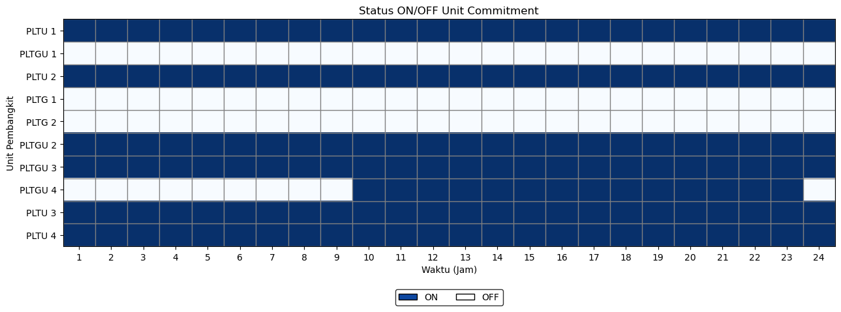
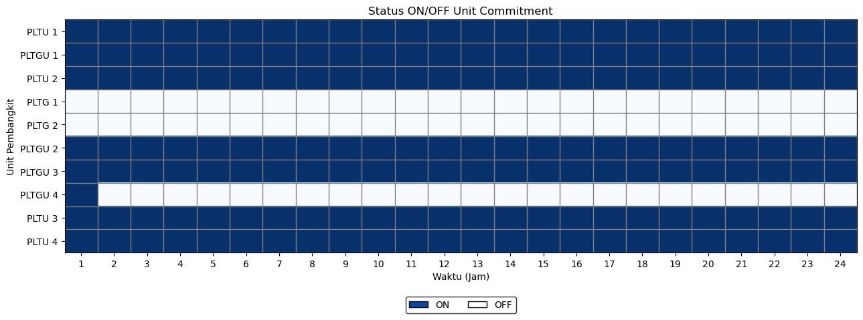
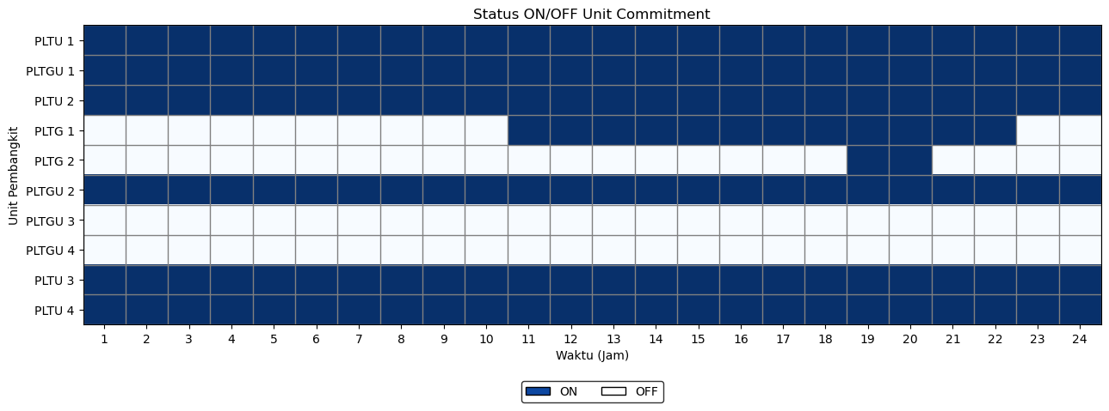
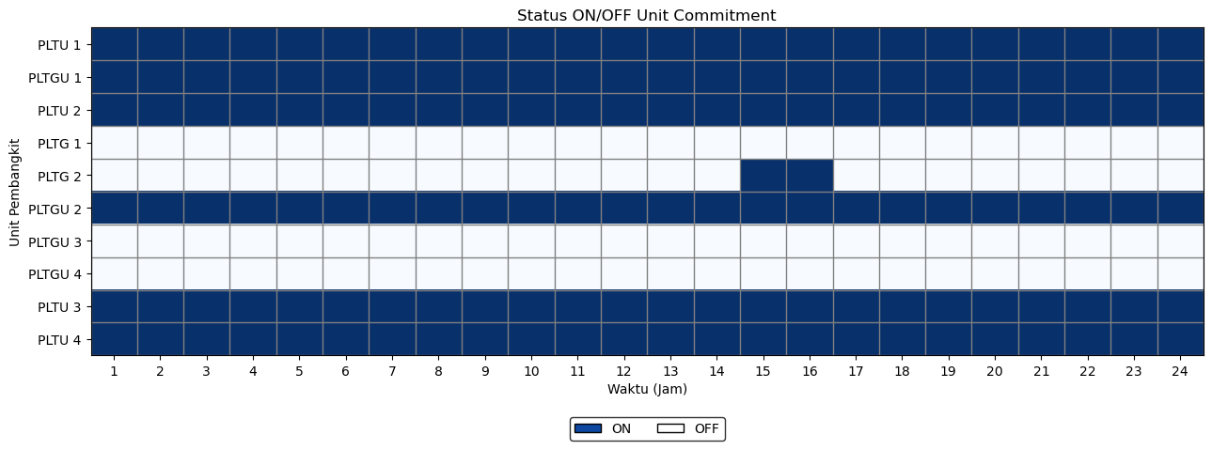
Status Unit (1)
#1
#4
#2
#5
#3
#6

Slide 16
Status Unit (2)
#7

Slide 17
Dispatch (1)
#1
Gen |  | Hour
 |  | 1 | 2 | 3 | 4 | 5 | 6 | 7 | 8 | 9 | 10 | 11 | 12 | 13 | 14 | 15 | 16 | 17 | 18 | 19 | 20 | 21 | 22 | 23 | 24
G 01 | PLTU 1 | 1176 | 1176 | 1176 | 1176 | 1176 | 1176 | 1176 | 1167.69 | 1176 | 1176 | 1176 | 1176 | 1176 | 1176 | 1176 | 1176 | 1176 | 1176 | 1176 | 1176 | 1176 | 1176 | 1176 | 1176
G 02 | PLTGU 1 | 0 | 0 | 0 | 0 | 0 | 0 | 0 | 0 | 0 | 0 | 0 | 0 | 0 | 0 | 0 | 0 | 0 | 0 | 0 | 0 | 0 | 0 | 0 | 0
G 03 | PLTU 2 | 720 | 840 | 915.2 | 827.52 | 707.52 | 827.52 | 889.06 | 849 | 969 | 969 | 969 | 969 | 969 | 969 | 969 | 969 | 969 | 969 | 969 | 969 | 969 | 969 | 969 | 969
G 04 | PLTG 1 | 0 | 0 | 0 | 0 | 0 | 0 | 0 | 0 | 0 | 0 | 0 | 0 | 0 | 0 | 0 | 0 | 0 | 0 | 0 | 0 | 0 | 0 | 0 | 0
G 05 | PLTG 2 | 0 | 0 | 0 | 0 | 0 | 0 | 0 | 0 | 0 | 0 | 0 | 0 | 0 | 0 | 0 | 0 | 0 | 0 | 0 | 0 | 0 | 0 | 0 | 0
G 06 | PLTGU 2 | 550 | 289.17 | 250 | 250 | 250 | 250 | 250 | 250 | 250 | 396.22 | 250 | 250 | 299.47 | 250 | 250 | 250 | 250 | 250 | 250 | 250 | 250 | 250 | 250 | 393.26
G 07 | PLTGU 3 | 399.68 | 248 | 248 | 248 | 248 | 248 | 248 | 248 | 426.45 | 248 | 496.87 | 248 | 248 | 248 | 548 | 609.74 | 547.6 | 447.71 | 248 | 548 | 248 | 441.61 | 250.67 | 248
G 08 | PLTGU 4 | 0 | 0 | 0 | 0 | 0 | 0 | 0 | 0 | 0 | 347.85 | 379.12 | 679.12 | 379.12 | 602.81 | 454.43 | 347.85 | 347.85 | 347.85 | 599.27 | 479.4 | 727.68 | 427.68 | 347.85 | 0
G 09 | PLTU 3 | 660 | 780 | 660 | 667.86 | 787.86 | 870 | 870 | 870 | 870 | 870 | 870 | 870 | 870 | 870 | 870 | 870 | 870 | 870 | 870 | 870 | 870 | 870 | 870 | 870
G 10 | PLTU 4 | 720 | 840 | 840 | 840 | 840 | 840 | 840 | 840 | 840 | 840 | 840 | 840 | 840 | 840 | 840 | 840 | 840 | 840 | 840 | 840 | 840 | 840 | 840 | 840
B 01 | Battery 1 | 0 | 0 | 0 | 0 | 0 | 0 | 0 | 0 | 0 | 0 | 0 | 0 | 0 | 0 | 0 | 0 | 0 | 0 | 0 | 0 | 0 | 0 | 0 | 0
B 02 | Battery 2 | 0 | 0 | 0 | 0 | 0 | 0 | 0 | 0 | 0 | 0 | 0 | 0 | 0 | 0 | 0 | 0 | 0 | 0 | 0 | 0 | 0 | 0 | 0 | 0
WT | Wind | 0 | 0 | 0 | 0 | 0 | 0 | 0 | 0 | 0 | 0 | 0 | 0 | 0 | 0 | 0 | 0 | 0 | 0 | 0 | 0 | 0 | 0 | 0 | 0
#2
Gen |  | Hour
 |  | 1 | 2 | 3 | 4 | 5 | 6 | 7 | 8 | 9 | 10 | 11 | 12 | 13 | 14 | 15 | 16 | 17 | 18 | 19 | 20 | 21 | 22 | 23 | 24
G 01 | PLTU 1 | 1176 | 1176 | 1176 | 1176 | 1176 | 1176 | 1176 | 1155.69 | 1176 | 1176 | 1176 | 1176 | 1176 | 1176 | 1176 | 1176 | 1176 | 1176 | 1176 | 1176 | 1176 | 1176 | 1176 | 1176
G 02 | PLTGU 1 | 379.18 | 340 | 340 | 340 | 340 | 340 | 340 | 340 | 422.07 | 722.07 | 470.98 | 765.81 | 465.81 | 765.81 | 537.43 | 340 | 340 | 340 | 479.87 | 340 | 602.6 | 484.3 | 536.96 | 340
G 03 | PLTU 2 | 720 | 840 | 876.03 | 969 | 863.38 | 969 | 969 | 969 | 969 | 969 | 969 | 969 | 969 | 969 | 969 | 969 | 969 | 969 | 969 | 969 | 969 | 969 | 969 | 969
G 04 | PLTG 1 | 0 | 0 | 0 | 0 | 0 | 0 | 0 | 0 | 0 | 0 | 85 | 85 | 85 | 85 | 85 | 85 | 85 | 85 | 85 | 85 | 85 | 85 | 0 | 0
G 05 | PLTG 2 | 0 | 0 | 0 | 0 | 0 | 0 | 0 | 0 | 0 | 0 | 0 | 0 | 0 | 0 | 0 | 0 | 0 | 0 | 66 | 66 | 0 | 0 | 0 | 0
G 06 | PLTGU 2 | 550 | 250 | 250 | 250 | 250 | 250 | 250 | 250 | 254.38 | 250 | 550 | 286.3 | 455.77 | 250 | 550 | 749 | 734.04 | 700.56 | 486.4 | 786.4 | 486.4 | 550 | 250 | 250
G 07 | PLTGU 3 | 0 | 0 | 0 | 0 | 0 | 0 | 0 | 0 | 0 | 0 | 0 | 0 | 0 | 0 | 0 | 0 | 0 | 0 | 0 | 0 | 0 | 0 | 0 | 0
G 08 | PLTGU 4 | 0 | 0 | 0 | 0 | 0 | 0 | 0 | 0 | 0 | 0 | 0 | 0 | 0 | 0 | 0 | 0 | 0 | 0 | 0 | 0 | 0 | 0 | 0 | 0
G 09 | PLTU 3 | 660 | 727.17 | 607.17 | 540 | 540 | 636.52 | 756.52 | 870 | 870 | 870 | 870 | 870 | 870 | 870 | 870 | 870 | 870 | 870 | 870 | 870 | 870 | 870 | 870 | 870
G 10 | PLTU 4 | 720 | 840 | 840 | 780.92 | 840 | 840 | 840 | 720 | 840 | 840 | 840 | 840 | 840 | 840 | 840 | 840 | 840 | 840 | 840 | 840 | 840 | 840 | 840 | 840
B 01 | Battery 1 | 5.50 | 0.00 | 0.00 | -26.54 | 0.00 | 0.00 | -58.46 | -60.00 | 0.00 | 0.00 | 0.00 | 60.00 | -60.00 | 0.00 | 60.00 | 13.59 | -13.59 | -60.00 | 0.00 | 0.00 | 51.68 | 0.00 | 56.56 | 31.26
B 02 | Battery 2 | 15.00 | 0.00 | 0.00 | -20.00 | 0.00 | 0.00 | 0.00 | -20.00 | 0.00 | 20.00 | 20.00 | -20.00 | -20.00 | 0.00 | 20.00 | 20.00 | 0.00 | -20.00 | -20.00 | 0.00 | 0.00 | 0.00 | 5.00 | 20.00
WT | Wind | 0.00 | 0.00 | 0.00 | 0.00 | 0.00 | 0.00 | 0.00 | 0.00 | 0.00 | 0.00 | 0.00 | 0.00 | 0.00 | 0.00 | 0.00 | 0.00 | 0.00 | 0.00 | 0.00 | 0.00 | 0.00 | 0.00 | 0.00 | 0.00
#3
Gen |  | Hour
 |  | 1 | 2 | 3 | 4 | 5 | 6 | 7 | 8 | 9 | 10 | 11 | 12 | 13 | 14 | 15 | 16 | 17 | 18 | 19 | 20 | 21 | 22 | 23 | 24
G 01 | PLTU 1 | 1176 | 1176 | 1176 | 1176 | 1176 | 1159.14 | 1054.89 | 1038.36 | 1158.36 | 1176 | 1176 | 1176 | 1176 | 1176 | 1176 | 1176 | 1176 | 1176 | 1176 | 1176 | 1176 | 1176 | 1176 | 1176
G 02 | PLTGU 1 | 340 | 340 | 340 | 340 | 340 | 340 | 340 | 340 | 340 | 351.09 | 527.32 | 726.55 | 638.04 | 656.78 | 449.34 | 640 | 340 | 528.27 | 613.57 | 716.02 | 660.19 | 591.93 | 379.05 | 340
G 03 | PLTU 2 | 659.18 | 600 | 715.77 | 703.18 | 600 | 600 | 609 | 729 | 849 | 969 | 969 | 969 | 969 | 969 | 969 | 969 | 969 | 969 | 969 | 969 | 969 | 969 | 969 | 969
G 04 | PLTG 1 | 0 | 0 | 0 | 0 | 0 | 0 | 0 | 0 | 0 | 0 | 0 | 0 | 0 | 0 | 0 | 0 | 0 | 0 | 0 | 0 | 0 | 0 | 0 | 0
G 05 | PLTG 2 | 0 | 0 | 0 | 0 | 0 | 0 | 0 | 0 | 0 | 0 | 0 | 0 | 0 | 0 | 66 | 66 | 0 | 0 | 0 | 0 | 0 | 0 | 0 | 0
G 06 | PLTGU 2 | 250 | 250 | 250 | 250 | 250 | 250 | 250 | 250 | 250 | 250 | 250 | 250 | 250 | 250 | 550 | 380.27 | 680.05 | 380.05 | 250 | 250 | 250 | 250 | 250 | 250
G 07 | PLTGU 3 | 0 | 0 | 0 | 0 | 0 | 0 | 0 | 0 | 0 | 0 | 0 | 0 | 0 | 0 | 0 | 0 | 0 | 0 | 0 | 0 | 0 | 0 | 0 | 0
G 08 | PLTGU 4 | 0 | 0 | 0 | 0 | 0 | 0 | 0 | 0 | 0 | 0 | 0 | 0 | 0 | 0 | 0 | 0 | 0 | 0 | 0 | 0 | 0 | 0 | 0 | 0
G 09 | PLTU 3 | 660 | 628.66 | 540 | 631.63 | 751.63 | 870 | 870 | 870 | 785.5 | 870 | 870 | 870 | 870 | 870 | 870 | 870 | 870 | 870 | 870 | 870 | 870 | 870 | 870 | 870
G 10 | PLTU 4 | 720 | 840 | 720 | 600 | 600 | 720 | 840 | 840 | 840 | 840 | 840 | 840 | 840 | 840 | 840 | 840 | 840 | 840 | 840 | 840 | 840 | 840 | 840 | 771.45
B 01 | Battery 1 | 5.50 | 0.00 | 0.00 | -25.00 | -60.00 | 0.00 | 0.00 | -60.00 | 0.00 | 0.00 | 60.00 | 0.00 | -60.00 | 60.00 | 60.00 | 0.00 | -60.00 | -60.00 | 0.00 | 25.00 | 60.00 | 60.00 | 0.00 | -5.50
B 02 | Battery 2 | 15.00 | 0.00 | 0.00 | 0.00 | -20.00 | 0.00 | 0.00 | -20.00 | 0.00 | 0.00 | 0.00 | 20.00 | -20.00 | 0.00 | 0.00 | 20.00 | 0.00 | -20.00 | 0.00 | 20.00 | 0.00 | 20.00 | 0.00 | -15.00
WT | Wind | 400 | 338.51 | 347.43 | 333.57 | 371.75 | 272.38 | 309.17 | 237.33 | 308.59 | 390.99 | 288.67 | 180.56 | 118.54 | 134.03 | 127.09 | 101.32 | 185.4 | 217.23 | 233.7 | 266.38 | 255.5 | 197.37 | 219.46 | 140.31

Slide 18
Dispatch (2)
#4
Gen |  | Hour
 |  | 1 | 2 | 3 | 4 | 5 | 6 | 7 | 8 | 9 | 10 | 11 | 12 | 13 | 14 | 15 | 16 | 17 | 18 | 19 | 20 | 21 | 22 | 23 | 24
G 01 | PLTU 1 | 1056 | 939.18 | 819.18 | 699.18 | 819.18 | 724.34 | 785.88 | 819.18 | 939.18 | 939.18 | 939.18 | 939.18 | 939.18 | 939.18 | 939.18 | 939.18 | 939.18 | 939.18 | 939.18 | 939.18 | 939.18 | 939.18 | 939.18 | 939.18
G 02 | PLTGU 1 | 340 | 340 | 340 | 340 | 340 | 340 | 340 | 340 | 445.09 | 340 | 340 | 395.22 | 695.22 | 395.22 | 340 | 340 | 340 | 340 | 340 | 340 | 340 | 340 | 340 | 409.9
G 03 | PLTU 2 | 720 | 840 | 819.18 | 939.18 | 819.18 | 939.18 | 939.18 | 939.18 | 939.18 | 939.18 | 939.18 | 939.18 | 939.18 | 939.18 | 939.18 | 939.18 | 939.18 | 939.18 | 939.18 | 939.18 | 939.18 | 939.18 | 939.18 | 939.18
G 04 | PLTG 1 | 0 | 0 | 0 | 0 | 0 | 0 | 0 | 0 | 0 | 0 | 0 | 0 | 0 | 0 | 0 | 0 | 0 | 0 | 0 | 0 | 0 | 0 | 0 | 0
G 05 | PLTG 2 | 0 | 0 | 0 | 0 | 0 | 0 | 0 | 0 | 0 | 0 | 0 | 0 | 0 | 0 | 0 | 0 | 0 | 0 | 0 | 0 | 0 | 0 | 0 | 0
G 06 | PLTGU 2 | 250 | 250 | 250 | 250 | 250 | 250 | 250 | 250 | 250 | 370.71 | 250 | 500.53 | 250 | 424.23 | 369.07 | 324.23 | 524.09 | 724.2 | 475.91 | 394.04 | 604.32 | 797.94 | 527.16 | 250
G 07 | PLTGU 3 | 248 | 300.16 | 248 | 248 | 248 | 248 | 248 | 248 | 248 | 548 | 802.62 | 548 | 248 | 548 | 810 | 810 | 548 | 248 | 548 | 810 | 548 | 248 | 248 | 248
G 08 | PLTGU 4 | 347.85 | 0 | 0 | 0 | 0 | 0 | 0 | 0 | 0 | 0 | 0 | 0 | 0 | 0 | 0 | 0 | 0 | 0 | 0 | 0 | 0 | 0 | 0 | 0
G 09 | PLTU 3 | 543.83 | 663.83 | 772.84 | 693.02 | 813.02 | 870 | 870 | 788.33 | 870 | 870 | 870 | 870 | 870 | 870 | 870 | 870 | 870 | 870 | 870 | 870 | 870 | 870 | 870 | 870
G 10 | PLTU 4 | 720 | 840 | 840 | 840 | 720 | 840 | 840 | 840 | 840 | 840 | 840 | 840 | 840 | 840 | 840 | 840 | 840 | 840 | 840 | 840 | 840 | 840 | 840 | 840
B 01 | Battery 1 | 0 | 0 | 0 | 0 | 0 | 0 | 0 | 0 | 0 | 0 | 0 | 0 | 0 | 0 | 0 | 0 | 0 | 0 | 0 | 0 | 0 | 0 | 0 | 0
B 02 | Battery 2 | 0 | 0 | 0 | 0 | 0 | 0 | 0 | 0 | 0 | 0 | 0 | 0 | 0 | 0 | 0 | 0 | 0 | 0 | 0 | 0 | 0 | 0 | 0 | 0
WT | Wind | 0 | 0 | 0 | 0 | 0 | 0 | 0 | 0 | 0 | 0 | 0 | 0 | 0 | 0 | 0 | 0 | 0 | 0 | 0 | 0 | 0 | 0 | 0 | 0
#5
Gen |  | Hour
 |  | 1 | 2 | 3 | 4 | 5 | 6 | 7 | 8 | 9 | 10 | 11 | 12 | 13 | 14 | 15 | 16 | 17 | 18 | 19 | 20 | 21 | 22 | 23 | 24
G 01 | PLTU 1 | 1056 | 936 | 816 | 696 | 627 | 665.88 | 785.88 | 819.18 | 939.18 | 939.18 | 939.18 | 939.18 | 939.18 | 939.18 | 939.18 | 939.18 | 939.18 | 939.18 | 939.18 | 939.18 | 939.18 | 939.18 | 939.18 | 939.18
G 02 | PLTGU 1 | 340 | 340 | 340 | 340 | 340 | 340 | 340 | 340 | 340 | 340 | 340 | 340 | 340 | 340 | 640 | 340 | 640 | 545.91 | 845.91 | 939.18 | 639.18 | 340 | 637.66 | 340
G 03 | PLTU 2 | 720 | 840 | 917.79 | 797.79 | 914.38 | 939.18 | 939.18 | 915.97 | 939.18 | 939.18 | 939.18 | 939.18 | 939.18 | 939.18 | 939.18 | 939.18 | 939.18 | 939.18 | 939.18 | 939.18 | 939.18 | 939.18 | 939.18 | 939.18
G 04 | PLTG 1 | 0 | 0 | 0 | 0 | 0 | 0 | 0 | 0 | 0 | 0 | 0 | 0 | 0 | 0 | 0 | 0 | 0 | 0 | 0 | 0 | 0 | 0 | 0 | 0
G 05 | PLTG 2 | 0 | 0 | 0 | 0 | 0 | 0 | 0 | 0 | 0 | 0 | 0 | 0 | 0 | 0 | 0 | 0 | 0 | 0 | 0 | 0 | 0 | 0 | 0 | 0
G 06 | PLTGU 2 | 250 | 250 | 250 | 250 | 250 | 250 | 250 | 250 | 250 | 250 | 258.24 | 475.76 | 685.22 | 779.45 | 571.07 | 586.23 | 286.23 | 278.28 | 250 | 276.86 | 576.86 | 550 | 250 | 250
G 07 | PLTGU 3 | 248 | 248 | 248 | 248 | 248 | 248 | 248 | 248 | 353.09 | 653.09 | 810 | 548 | 248 | 248 | 248 | 548 | 485.86 | 548 | 248 | 248 | 248 | 439.22 | 248 | 317.9
G 08 | PLTGU 4 | 347.85 | 0 | 0 | 0 | 0 | 0 | 0 | 0 | 0 | 0 | 0 | 0 | 0 | 0 | 0 | 0 | 0 | 0 | 0 | 0 | 0 | 0 | 0 | 0
G 09 | PLTU 3 | 561.25 | 681.25 | 750 | 870 | 870 | 870 | 870 | 870 | 870 | 870 | 870 | 870 | 870 | 870 | 870 | 870 | 870 | 870 | 870 | 870 | 870 | 870 | 870 | 870
G 10 | PLTU 4 | 720 | 840 | 840 | 840 | 840 | 840 | 840 | 840 | 840 | 840 | 840 | 840 | 840 | 840 | 840 | 840 | 840 | 840 | 840 | 840 | 840 | 840 | 840 | 840
B 01 | Battery 1 | -12.42 | 17.92 | -52.59 | -32.41 | -60.00 | 58.46 | 0.00 | -58.46 | 0.00 | 15.62 | -15.62 | 60.00 | -60.00 | 0.00 | 60.00 | 0.00 | 0.00 | -60.00 | 0.00 | 60.00 | 28.28 | 56.72 | -5.50 | 0.00
B 02 | Battery 2 | -5.00 | 20.00 | -20.00 | 0.00 | -20.00 | 0.00 | 0.00 | 0.00 | 0.00 | 0.00 | 0.00 | 20.00 | -20.00 | 0.00 | 0.00 | 0.00 | 0.00 | 0.00 | 20.00 | 20.00 | 0.00 | 0.00 | -15.00 | 0.00
WT | Wind | 0 | 0 | 0 | 0 | 0 | 0 | 0 | 0 | 0 | 0 | 0 | 0 | 0 | 0 | 0 | 0 | 0 | 0 | 0 | 0 | 0 | 0 | 0 | 0
#6
Gen |  | Hour
 |  | 1 | 2 | 3 | 4 | 5 | 6 | 7 | 8 | 9 | 10 | 11 | 12 | 13 | 14 | 15 | 16 | 17 | 18 | 19 | 20 | 21 | 22 | 23 | 24
G 01 | PLTU 1 | 1056 | 936 | 816 | 696 | 627 | 627 | 627 | 703.68 | 819.18 | 939.18 | 939.18 | 939.18 | 939.18 | 939.18 | 939.18 | 939.18 | 939.18 | 939.18 | 939.18 | 939.18 | 939.18 | 939.18 | 939.18 | 889.27
G 02 | PLTGU 1 | 340 | 340 | 340 | 340 | 340 | 340 | 340 | 340 | 340 | 340 | 340 | 640 | 340 | 435.42 | 631.98 | 372.91 | 340 | 340 | 340 | 358.83 | 658.83 | 365.57 | 340 | 340
G 03 | PLTU 2 | 600 | 600.66 | 600 | 600 | 644.14 | 764.14 | 847.43 | 735.68 | 855.68 | 939.18 | 939.18 | 939.18 | 939.18 | 939.18 | 939.18 | 939.18 | 939.18 | 939.18 | 939.18 | 939.18 | 939.18 | 939.18 | 939.18 | 939.18
G 04 | PLTG 1 | 0 | 0 | 0 | 0 | 0 | 0 | 0 | 0 | 0 | 0 | 0 | 0 | 0 | 0 | 0 | 0 | 0 | 0 | 0 | 0 | 0 | 0 | 0 | 0
G 05 | PLTG 2 | 0 | 0 | 0 | 0 | 0 | 0 | 0 | 0 | 0 | 0 | 0 | 0 | 0 | 0 | 0 | 0 | 0 | 0 | 0 | 0 | 0 | 0 | 0 | 0
G 06 | PLTGU 2 | 250 | 250 | 250 | 250 | 250 | 250 | 250 | 250 | 250 | 279.73 | 250 | 250 | 486.68 | 250 | 250 | 250 | 250 | 418.27 | 250 | 550 | 250 | 250 | 250 | 250
G 07 | PLTGU 3 | 248 | 248 | 248 | 248 | 248 | 248 | 248 | 248 | 248 | 248 | 513.96 | 313.19 | 248 | 548 | 510 | 810 | 636.69 | 336.69 | 520.21 | 308.83 | 248 | 548 | 305.69 | 248
G 08 | PLTGU 4 | 347.85 | 0 | 0 | 0 | 0 | 0 | 0 | 0 | 0 | 0 | 0 | 0 | 0 | 0 | 0 | 0 | 0 | 0 | 0 | 0 | 0 | 0 | 0 | 0
G 09 | PLTU 3 | 540 | 660 | 750 | 870 | 750 | 870 | 870 | 870 | 870 | 870 | 870 | 870 | 870 | 870 | 870 | 870 | 870 | 870 | 870 | 870 | 870 | 870 | 870 | 870
G 10 | PLTU 4 | 600 | 720 | 817.77 | 697.77 | 778.49 | 840 | 840 | 840 | 840 | 840 | 840 | 840 | 840 | 840 | 840 | 840 | 840 | 840 | 840 | 840 | 840 | 840 | 840 | 840
B 01 | Battery 1 | -60.00 | 60.00 | -60.00 | -25.96 | 0.00 | 0.00 | -53.54 | 0.00 | 0.00 | 0.00 | 0.00 | 60.00 | 0.00 | 0.00 | 0.00 | -60.00 | 0.00 | 0.00 | 0.00 | 60.00 | 60.00 | 25.00 | 0.00 | -5.50
B 02 | Battery 2 | -20.00 | 20.00 | -20.00 | 0.00 | 0.00 | 0.00 | -5.00 | 0.00 | 0.00 | 0.00 | 0.00 | 0.00 | 0.00 | 0.00 | 0.00 | 0.00 | 0.00 | 0.00 | 20.00 | 0.00 | 20.00 | 0.00 | 0.00 | -15.00
WT | Wind | 323.83 | 338.51 | 347.43 | 333.57 | 371.75 | 272.38 | 309.17 | 237.33 | 308.59 | 390.99 | 288.67 | 180.56 | 118.54 | 134.03 | 127.09 | 101.32 | 185.4 | 217.23 | 233.7 | 266.38 | 255.5 | 197.37 | 219.46 | 140.31

Slide 19
Dispatch (3)
#7
Gen |  | Hour
 |  | 1 | 2 | 3 | 4 | 5 | 6 | 7 | 8 | 9 | 10 | 11 | 12 | 13 | 14 | 15 | 16 | 17 | 18 | 19 | 20 | 21 | 22 | 23 | 24
G 01 | PLTU 1 | 1056 | 936 | 816 | 747 | 627 | 658.01 | 627 | 707.98 | 827.98 | 947.98 | 947.98 | 945.23 | 941.38 | 947.98 | 947.98 | 947.98 | 947.98 | 947.98 | 947.98 | 947.98 | 941.38 | 945.78 | 945.78 | 939.18
G 02 | PLTGU 1 | 340 | 340 | 340 | 340 | 340 | 340 | 340 | 340 | 340 | 340 | 588.36 | 340 | 512.28 | 417.82 | 340 | 340 | 340 | 508.27 | 340 | 427.63 | 340 | 340 | 340 | 340
G 03 | PLTU 2 | 600 | 680.66 | 707.77 | 630.81 | 677.63 | 797.63 | 868.89 | 781.63 | 901.63 | 947.98 | 947.98 | 945.23 | 941.38 | 947.98 | 947.98 | 947.98 | 947.98 | 947.98 | 947.98 | 947.98 | 941.38 | 945.78 | 945.78 | 939.18
G 04 | PLTG 1 | 0 | 0 | 0 | 0 | 0 | 0 | 0 | 0 | 0 | 0 | 0 | 0 | 0 | 0 | 0 | 0 | 0 | 0 | 0 | 0 | 0 | 0 | 0 | 0
G 05 | PLTG 2 | 0 | 0 | 0 | 0 | 0 | 0 | 0 | 0 | 0 | 0 | 0 | 0 | 0 | 0 | 0 | 0 | 0 | 0 | 0 | 0 | 0 | 0 | 0 | 0
G 06 | PLTGU 2 | 250 | 250 | 250 | 250 | 250 | 250 | 250 | 250 | 250 | 262.13 | 250 | 338.09 | 250 | 550 | 486.38 | 250 | 250 | 250 | 250 | 550 | 250 | 532.94 | 250 | 250
G 07 | PLTGU 3 | 248 | 248 | 248 | 248 | 248 | 248 | 248 | 248 | 248 | 248 | 248 | 548 | 248 | 248 | 548 | 765.31 | 619.09 | 319.09 | 522.61 | 282.43 | 582.43 | 282.43 | 272.49 | 248
G 08 | PLTGU 4 | 347.85 | 0 | 0 | 0 | 0 | 0 | 0 | 0 | 0 | 0 | 0 | 0 | 0 | 0 | 0 | 0 | 0 | 0 | 0 | 0 | 0 | 0 | 0 | 0
G 09 | PLTU 3 | 540 | 660 | 540 | 540 | 660 | 780 | 870 | 870 | 870 | 870 | 870 | 870 | 870 | 870 | 870 | 870 | 870 | 870 | 870 | 870 | 870 | 870 | 870 | 870
G 10 | PLTU 4 | 600 | 720 | 840 | 840 | 840 | 840 | 840 | 840 | 840 | 840 | 840 | 840 | 840 | 840 | 840 | 840 | 840 | 840 | 840 | 840 | 840 | 840 | 840 | 790.09
B 01 | Battery 1 | -60.00 | 0.00 | 0.00 | 60.00 | 0.00 | 5.50 | -60.00 | -30.25 | -54.75 | 0.00 | 0.00 | 25.00 | 60.00 | 0.00 | 0.00 | 0.00 | 0.00 | 0.00 | 0.00 | 0.00 | 60.00 | 0.00 | 0.00 | -5.50
B 02 | Battery 2 | -20.00 | 0.00 | 0.00 | 20.00 | -5.00 | 20.00 | -20.00 | -20.00 | 0.00 | 0.00 | 0.00 | 0.00 | 0.00 | 0.00 | 0.00 | 0.00 | 0.00 | 0.00 | 0.00 | 0.00 | 0.00 | 20.00 | 20.00 | -15.00
WT | Wind | 323.83 | 338.51 | 347.43 | 333.57 | 371.75 | 272.38 | 309.17 | 237.33 | 308.59 | 390.99 | 288.67 | 180.56 | 118.54 | 134.03 | 127.09 | 101.32 | 185.4 | 217.23 | 233.7 | 266.38 | 255.5 | 197.37 | 219.46 | 140.31

Slide 20
Reserve (1)
#1
Gen |  | Hour
 |  | 1 | 2 | 3 | 4 | 5 | 6 | 7 | 8 | 9 | 10 | 11 | 12 | 13 | 14 | 15 | 16 | 17 | 18 | 19 | 20 | 21 | 22 | 23 | 24
G 01 | PLTU 1 | 0 | 0 | 0 | 0 | 0 | 0 | 0 | 8.31 | 0 | 0 | 0 | 0 | 0 | 0 | 0 | 0 | 0 | 0 | 0 | 0 | 0 | 0 | 0 | 0
G 02 | PLTGU 1 | 0 | 0 | 0 | 0 | 0 | 0 | 0 | 0 | 0 | 0 | 0 | 0 | 0 | 0 | 0 | 0 | 0 | 0 | 0 | 0 | 0 | 0 | 0 | 0
G 03 | PLTU 2 | 249 | 129 | 53.8 | 141.48 | 261.48 | 141.48 | 79.94 | 120 | 0 | 0 | 0 | 0 | 0 | 0 | 0 | 0 | 0 | 0 | 0 | 0 | 0 | 0 | 0 | 0
G 04 | PLTG 1 | 0 | 0 | 0 | 0 | 0 | 0 | 0 | 0 | 0 | 0 | 0 | 0 | 0 | 0 | 0 | 0 | 0 | 0 | 0 | 0 | 0 | 0 | 0 | 0
G 05 | PLTG 2 | 0 | 0 | 0 | 0 | 0 | 0 | 0 | 0 | 0 | 0 | 0 | 0 | 0 | 0 | 0 | 0 | 0 | 0 | 0 | 0 | 0 | 0 | 0 | 0
G 06 | PLTGU 2 | 545 | 805.83 | 845 | 845 | 845 | 845 | 845 | 845 | 845 | 698.78 | 845 | 845 | 795.53 | 845 | 845 | 845 | 845 | 845 | 845 | 845 | 845 | 845 | 845 | 701.74
G 07 | PLTGU 3 | 410.32 | 562 | 562 | 562 | 562 | 562 | 562 | 562 | 383.55 | 562 | 313.13 | 562 | 562 | 562 | 262 | 200.26 | 262.4 | 362.29 | 562 | 262 | 562 | 368.39 | 559.33 | 562
G 08 | PLTGU 4 | 0 | 0 | 0 | 0 | 0 | 0 | 0 | 0 | 0 | 425.15 | 393.88 | 93.88 | 393.88 | 170.19 | 318.57 | 425.15 | 425.15 | 425.15 | 173.73 | 293.6 | 45.32 | 345.32 | 425.15 | 0
G 09 | PLTU 3 | 210 | 90 | 210 | 202.14 | 82.14 | 0 | 0 | 0 | 0 | 0 | 0 | 0 | 0 | 0 | 0 | 0 | 0 | 0 | 0 | 0 | 0 | 0 | 0 | 0
G 10 | PLTU 4 | 120 | 0 | 0 | 0 | 0 | 0 | 0 | 0 | 0 | 0 | 0 | 0 | 0 | 0 | 0 | 0 | 0 | 0 | 0 | 0 | 0 | 0 | 0 | 0
B 01 | Battery 1 | 0 | 0 | 0 | 0 | 0 | 0 | 0 | 0 | 0 | 0 | 0 | 0 | 0 | 0 | 0 | 0 | 0 | 0 | 0 | 0 | 0 | 0 | 0 | 0
B 02 | Battery 2 | 0 | 0 | 0 | 0 | 0 | 0 | 0 | 0 | 0 | 0 | 0 | 0 | 0 | 0 | 0 | 0 | 0 | 0 | 0 | 0 | 0 | 0 | 0 | 0
WT | Wind | 0 | 0 | 0 | 0 | 0 | 0 | 0 | 0 | 0 | 0 | 0 | 0 | 0 | 0 | 0 | 0 | 0 | 0 | 0 | 0 | 0 | 0 | 0 | 0
#2
Gen |  | Hour
 |  | 1 | 2 | 3 | 4 | 5 | 6 | 7 | 8 | 9 | 10 | 11 | 12 | 13 | 14 | 15 | 16 | 17 | 18 | 19 | 20 | 21 | 22 | 23 | 24
G 01 | PLTU 1 | 0 | 0 | 0 | 0 | 0 | 0 | 0 | 20.31 | 0 | 0 | 0 | 0 | 0 | 0 | 0 | 0 | 0 | 0 | 0 | 0 | 0 | 0 | 0 | 0
G 02 | PLTGU 1 | 745.82 | 785 | 785 | 785 | 785 | 785 | 785 | 785 | 702.93 | 402.93 | 654.02 | 359.19 | 659.19 | 359.19 | 587.57 | 785 | 785 | 785 | 645.13 | 785 | 522.4 | 640.7 | 588.04 | 785
G 03 | PLTU 2 | 249 | 129 | 92.97 | 0 | 105.62 | 0 | 0 | 0 | 0 | 0 | 0 | 0 | 0 | 0 | 0 | 0 | 0 | 0 | 0 | 0 | 0 | 0 | 0 | 0
G 04 | PLTG 1 | 0 | 0 | 0 | 0 | 0 | 0 | 0 | 0 | 0 | 0 | 45 | 45 | 45 | 45 | 45 | 45 | 45 | 45 | 45 | 45 | 45 | 45 | 0 | 0
G 05 | PLTG 2 | 0 | 0 | 0 | 0 | 0 | 0 | 0 | 0 | 0 | 0 | 0 | 0 | 0 | 0 | 0 | 0 | 0 | 0 | 42 | 42 | 0 | 0 | 0 | 0
G 06 | PLTGU 2 | 545 | 845 | 845 | 845 | 845 | 845 | 845 | 845 | 840.62 | 845 | 545 | 808.7 | 639.23 | 845 | 545 | 346 | 360.96 | 394.44 | 608.6 | 308.6 | 608.6 | 545 | 845 | 845
G 07 | PLTGU 3 | 0 | 0 | 0 | 0 | 0 | 0 | 0 | 0 | 0 | 0 | 0 | 0 | 0 | 0 | 0 | 0 | 0 | 0 | 0 | 0 | 0 | 0 | 0 | 0
G 08 | PLTGU 4 | 0 | 0 | 0 | 0 | 0 | 0 | 0 | 0 | 0 | 0 | 0 | 0 | 0 | 0 | 0 | 0 | 0 | 0 | 0 | 0 | 0 | 0 | 0 | 0
G 09 | PLTU 3 | 210 | 142.83 | 262.83 | 330 | 330 | 233.48 | 113.48 | 0 | 0 | 0 | 0 | 0 | 0 | 0 | 0 | 0 | 0 | 0 | 0 | 0 | 0 | 0 | 0 | 0
G 10 | PLTU 4 | 120 | 0 | 0 | 59.08 | 0 | 0 | 0 | 120 | 0 | 0 | 0 | 0 | 0 | 0 | 0 | 0 | 0 | 0 | 0 | 0 | 0 | 0 | 0 | 0
B 01 | Battery 1 | 0 | 0 | 0 | 0 | 0 | 0 | 0 | 0 | 0 | 0 | 0 | 0 | 0 | 0 | 0 | 0 | 0 | 0 | 0 | 0 | 0 | 0 | 0 | 0
B 02 | Battery 2 | 0 | 0 | 0 | 0 | 0 | 0 | 0 | 0 | 0 | 0 | 0 | 0 | 0 | 0 | 0 | 0 | 0 | 0 | 0 | 0 | 0 | 0 | 0 | 0
WT | Wind | 0 | 0 | 0 | 0 | 0 | 0 | 0 | 0 | 0 | 0 | 0 | 0 | 0 | 0 | 0 | 0 | 0 | 0 | 0 | 0 | 0 | 0 | 0 | 0
#3
Gen |  | Hour
 |  | 1 | 2 | 3 | 4 | 5 | 6 | 7 | 8 | 9 | 10 | 11 | 12 | 13 | 14 | 15 | 16 | 17 | 18 | 19 | 20 | 21 | 22 | 23 | 24
G 01 | PLTU 1 | 0 | 0 | 0 | 0 | 0 | 16.86 | 121.11 | 137.64 | 17.64 | 0 | 0 | 0 | 0 | 0 | 0 | 0 | 0 | 0 | 0 | 0 | 0 | 0 | 0 | 0
G 02 | PLTGU 1 | 785 | 785 | 785 | 785 | 785 | 785 | 785 | 785 | 785 | 773.91 | 597.68 | 398.45 | 486.96 | 468.22 | 675.66 | 485 | 785 | 596.73 | 511.43 | 408.98 | 464.81 | 533.07 | 745.95 | 785
G 03 | PLTU 2 | 309.82 | 369 | 253.23 | 265.82 | 369 | 369 | 360 | 240 | 120 | 0 | 0 | 0 | 0 | 0 | 0 | 0 | 0 | 0 | 0 | 0 | 0 | 0 | 0 | 0
G 04 | PLTG 1 | 0 | 0 | 0 | 0 | 0 | 0 | 0 | 0 | 0 | 0 | 0 | 0 | 0 | 0 | 0 | 0 | 0 | 0 | 0 | 0 | 0 | 0 | 0 | 0
G 05 | PLTG 2 | 0 | 0 | 0 | 0 | 0 | 0 | 0 | 0 | 0 | 0 | 0 | 0 | 0 | 0 | 42 | 42 | 0 | 0 | 0 | 0 | 0 | 0 | 0 | 0
G 06 | PLTGU 2 | 845 | 845 | 845 | 845 | 845 | 845 | 845 | 845 | 845 | 845 | 845 | 845 | 845 | 845 | 545 | 714.73 | 414.95 | 714.95 | 845 | 845 | 845 | 845 | 845 | 845
G 07 | PLTGU 3 | 0 | 0 | 0 | 0 | 0 | 0 | 0 | 0 | 0 | 0 | 0 | 0 | 0 | 0 | 0 | 0 | 0 | 0 | 0 | 0 | 0 | 0 | 0 | 0
G 08 | PLTGU 4 | 0 | 0 | 0 | 0 | 0 | 0 | 0 | 0 | 0 | 0 | 0 | 0 | 0 | 0 | 0 | 0 | 0 | 0 | 0 | 0 | 0 | 0 | 0 | 0
G 09 | PLTU 3 | 210 | 241.34 | 330 | 238.37 | 118.37 | 0 | 0 | 0 | 84.5 | 0 | 0 | 0 | 0 | 0 | 0 | 0 | 0 | 0 | 0 | 0 | 0 | 0 | 0 | 0
G 10 | PLTU 4 | 120 | 0 | 120 | 240 | 240 | 120 | 0 | 0 | 0 | 0 | 0 | 0 | 0 | 0 | 0 | 0 | 0 | 0 | 0 | 0 | 0 | 0 | 0 | 68.55
B 01 | Battery 1 | 0 | 0 | 0 | 0 | 0 | 0 | 0 | 0 | 0 | 0 | 0 | 0 | 0 | 0 | 0 | 0 | 0 | 0 | 0 | 0 | 0 | 0 | 0 | 0
B 02 | Battery 2 | 0 | 0 | 0 | 0 | 0 | 0 | 0 | 0 | 0 | 0 | 0 | 0 | 0 | 0 | 0 | 0 | 0 | 0 | 0 | 0 | 0 | 0 | 0 | 0
WT | Wind | 0 | 0 | 0 | 0 | 0 | 0 | 0 | 0 | 0 | 0 | 0 | 0 | 0 | 0 | 0 | 0 | 0 | 0 | 0 | 0 | 0 | 0 | 0 | 0

Slide 21
Reserve (2)
#4
Gen |  | Hour
 |  | 1 | 2 | 3 | 4 | 5 | 6 | 7 | 8 | 9 | 10 | 11 | 12 | 13 | 14 | 15 | 16 | 17 | 18 | 19 | 20 | 21 | 22 | 23 | 24
G 01 | PLTU 1 | 120 | 236.82 | 356.82 | 476.82 | 356.82 | 451.66 | 390.12 | 356.82 | 236.82 | 236.82 | 236.82 | 236.82 | 236.82 | 236.82 | 236.82 | 236.82 | 236.82 | 236.82 | 236.82 | 236.82 | 236.82 | 236.82 | 236.82 | 236.82
G 02 | PLTGU 1 | 785 | 785 | 785 | 785 | 785 | 785 | 785 | 785 | 679.91 | 785 | 785 | 729.78 | 429.78 | 729.78 | 785 | 785 | 785 | 785 | 785 | 785 | 785 | 785 | 785 | 715.1
G 03 | PLTU 2 | 249 | 129 | 149.82 | 29.82 | 149.82 | 29.82 | 29.82 | 29.82 | 29.82 | 29.82 | 29.82 | 29.82 | 29.82 | 29.82 | 29.82 | 29.82 | 29.82 | 29.82 | 29.82 | 29.82 | 29.82 | 29.82 | 29.82 | 29.82
G 04 | PLTG 1 | 0 | 0 | 0 | 0 | 0 | 0 | 0 | 0 | 0 | 0 | 0 | 0 | 0 | 0 | 0 | 0 | 0 | 0 | 0 | 0 | 0 | 0 | 0 | 0
G 05 | PLTG 2 | 0 | 0 | 0 | 0 | 0 | 0 | 0 | 0 | 0 | 0 | 0 | 0 | 0 | 0 | 0 | 0 | 0 | 0 | 0 | 0 | 0 | 0 | 0 | 0
G 06 | PLTGU 2 | 845 | 845 | 845 | 845 | 845 | 845 | 845 | 845 | 845 | 724.29 | 845 | 594.47 | 845 | 670.77 | 725.93 | 770.77 | 570.91 | 370.8 | 619.09 | 700.96 | 490.68 | 297.06 | 567.84 | 845
G 07 | PLTGU 3 | 562 | 509.84 | 562 | 562 | 562 | 562 | 562 | 562 | 562 | 262 | 7.38 | 262 | 562 | 262 | 0 | 0 | 262 | 562 | 262 | 0 | 262 | 562 | 562 | 562
G 08 | PLTGU 4 | 425.15 | 0 | 0 | 0 | 0 | 0 | 0 | 0 | 0 | 0 | 0 | 0 | 0 | 0 | 0 | 0 | 0 | 0 | 0 | 0 | 0 | 0 | 0 | 0
G 09 | PLTU 3 | 326.17 | 206.17 | 97.16 | 176.98 | 56.98 | 0 | 0 | 81.67 | 0 | 0 | 0 | 0 | 0 | 0 | 0 | 0 | 0 | 0 | 0 | 0 | 0 | 0 | 0 | 0
G 10 | PLTU 4 | 120 | 0 | 0 | 0 | 120 | 0 | 0 | 0 | 0 | 0 | 0 | 0 | 0 | 0 | 0 | 0 | 0 | 0 | 0 | 0 | 0 | 0 | 0 | 0
B 01 | Battery 1 | 0 | 0 | 0 | 0 | 0 | 0 | 0 | 0 | 0 | 0 | 0 | 0 | 0 | 0 | 0 | 0 | 0 | 0 | 0 | 0 | 0 | 0 | 0 | 0
B 02 | Battery 2 | 0 | 0 | 0 | 0 | 0 | 0 | 0 | 0 | 0 | 0 | 0 | 0 | 0 | 0 | 0 | 0 | 0 | 0 | 0 | 0 | 0 | 0 | 0 | 0
WT | Wind | 0 | 0 | 0 | 0 | 0 | 0 | 0 | 0 | 0 | 0 | 0 | 0 | 0 | 0 | 0 | 0 | 0 | 0 | 0 | 0 | 0 | 0 | 0 | 0
#5
Gen |  | Hour
 |  | 1 | 2 | 3 | 4 | 5 | 6 | 7 | 8 | 9 | 10 | 11 | 12 | 13 | 14 | 15 | 16 | 17 | 18 | 19 | 20 | 21 | 22 | 23 | 24
G 01 | PLTU 1 | 120 | 240 | 360 | 480 | 549 | 549 | 549 | 472.32 | 356.82 | 236.82 | 236.82 | 236.82 | 236.82 | 236.82 | 236.82 | 236.82 | 236.82 | 236.82 | 236.82 | 236.82 | 236.82 | 236.82 | 236.82 | 286.73
G 02 | PLTGU 1 | 785 | 785 | 785 | 785 | 785 | 785 | 785 | 785 | 785 | 785 | 785 | 485 | 785 | 689.58 | 493.02 | 752.09 | 785 | 785 | 785 | 766.17 | 466.17 | 759.43 | 785 | 785
G 03 | PLTU 2 | 369 | 368.34 | 369 | 369 | 324.86 | 204.86 | 121.57 | 233.32 | 113.32 | 29.82 | 29.82 | 29.82 | 29.82 | 29.82 | 29.82 | 29.82 | 29.82 | 29.82 | 29.82 | 29.82 | 29.82 | 29.82 | 29.82 | 29.82
G 04 | PLTG 1 | 0 | 0 | 0 | 0 | 0 | 0 | 0 | 0 | 0 | 0 | 0 | 0 | 0 | 0 | 0 | 0 | 0 | 0 | 0 | 0 | 0 | 0 | 0 | 0
G 05 | PLTG 2 | 0 | 0 | 0 | 0 | 0 | 0 | 0 | 0 | 0 | 0 | 0 | 0 | 0 | 0 | 0 | 0 | 0 | 0 | 0 | 0 | 0 | 0 | 0 | 0
G 06 | PLTGU 2 | 845 | 845 | 845 | 845 | 845 | 845 | 845 | 845 | 845 | 815.27 | 845 | 845 | 608.32 | 845 | 845 | 845 | 845 | 676.73 | 845 | 545 | 845 | 845 | 845 | 845
G 07 | PLTGU 3 | 562 | 562 | 562 | 562 | 562 | 562 | 562 | 562 | 562 | 562 | 296.04 | 496.81 | 562 | 262 | 300 | 0 | 173.31 | 473.31 | 289.79 | 501.17 | 562 | 262 | 504.31 | 562
G 08 | PLTGU 4 | 425.15 | 0 | 0 | 0 | 0 | 0 | 0 | 0 | 0 | 0 | 0 | 0 | 0 | 0 | 0 | 0 | 0 | 0 | 0 | 0 | 0 | 0 | 0 | 0
G 09 | PLTU 3 | 330 | 210 | 120 | 0 | 120 | 0 | 0 | 0 | 0 | 0 | 0 | 0 | 0 | 0 | 0 | 0 | 0 | 0 | 0 | 0 | 0 | 0 | 0 | 0
G 10 | PLTU 4 | 240 | 120 | 22.23 | 142.23 | 61.51 | 0 | 0 | 0 | 0 | 0 | 0 | 0 | 0 | 0 | 0 | 0 | 0 | 0 | 0 | 0 | 0 | 0 | 0 | 0
B 01 | Battery 1 | 0 | 0 | 0 | 0 | 0 | 0 | 0 | 0 | 0 | 0 | 0 | 0 | 0 | 0 | 0 | 0 | 0 | 0 | 0 | 0 | 0 | 0 | 0 | 0
B 02 | Battery 2 | 0 | 0 | 0 | 0 | 0 | 0 | 0 | 0 | 0 | 0 | 0 | 0 | 0 | 0 | 0 | 0 | 0 | 0 | 0 | 0 | 0 | 0 | 0 | 0
WT | Wind | 0 | 0 | 0 | 0 | 0 | 0 | 0 | 0 | 0 | 0 | 0 | 0 | 0 | 0 | 0 | 0 | 0 | 0 | 0 | 0 | 0 | 0 | 0 | 0
#6
Gen |  | Hour
 |  | 1 | 2 | 3 | 4 | 5 | 6 | 7 | 8 | 9 | 10 | 11 | 12 | 13 | 14 | 15 | 16 | 17 | 18 | 19 | 20 | 21 | 22 | 23 | 24
G 01 | PLTU 1 | 120 | 240 | 360 | 480 | 549 | 549 | 549 | 472.32 | 356.82 | 236.82 | 236.82 | 236.82 | 236.82 | 236.82 | 236.82 | 236.82 | 236.82 | 236.82 | 236.82 | 236.82 | 236.82 | 236.82 | 236.82 | 286.73
G 02 | PLTGU 1 | 785 | 785 | 785 | 785 | 785 | 785 | 785 | 785 | 785 | 785 | 785 | 485 | 785 | 689.58 | 493.02 | 752.09 | 785 | 785 | 785 | 766.17 | 466.17 | 759.43 | 785 | 785
G 03 | PLTU 2 | 369 | 368.34 | 369 | 369 | 324.86 | 204.86 | 121.57 | 233.32 | 113.32 | 29.82 | 29.82 | 29.82 | 29.82 | 29.82 | 29.82 | 29.82 | 29.82 | 29.82 | 29.82 | 29.82 | 29.82 | 29.82 | 29.82 | 29.82
G 04 | PLTG 1 | 0 | 0 | 0 | 0 | 0 | 0 | 0 | 0 | 0 | 0 | 0 | 0 | 0 | 0 | 0 | 0 | 0 | 0 | 0 | 0 | 0 | 0 | 0 | 0
G 05 | PLTG 2 | 0 | 0 | 0 | 0 | 0 | 0 | 0 | 0 | 0 | 0 | 0 | 0 | 0 | 0 | 0 | 0 | 0 | 0 | 0 | 0 | 0 | 0 | 0 | 0
G 06 | PLTGU 2 | 845 | 845 | 845 | 845 | 845 | 845 | 845 | 845 | 845 | 815.27 | 845 | 845 | 608.32 | 845 | 845 | 845 | 845 | 676.73 | 845 | 545 | 845 | 845 | 845 | 845
G 07 | PLTGU 3 | 562 | 562 | 562 | 562 | 562 | 562 | 562 | 562 | 562 | 562 | 296.04 | 496.81 | 562 | 262 | 300 | 0 | 173.31 | 473.31 | 289.79 | 501.17 | 562 | 262 | 504.31 | 562
G 08 | PLTGU 4 | 425.15 | 0 | 0 | 0 | 0 | 0 | 0 | 0 | 0 | 0 | 0 | 0 | 0 | 0 | 0 | 0 | 0 | 0 | 0 | 0 | 0 | 0 | 0 | 0
G 09 | PLTU 3 | 330 | 210 | 120 | 0 | 120 | 0 | 0 | 0 | 0 | 0 | 0 | 0 | 0 | 0 | 0 | 0 | 0 | 0 | 0 | 0 | 0 | 0 | 0 | 0
G 10 | PLTU 4 | 240 | 120 | 22.23 | 142.23 | 61.51 | 0 | 0 | 0 | 0 | 0 | 0 | 0 | 0 | 0 | 0 | 0 | 0 | 0 | 0 | 0 | 0 | 0 | 0 | 0
B 01 | Battery 1 | 0 | 0 | 0 | 0 | 0 | 0 | 0 | 0 | 0 | 0 | 0 | 0 | 0 | 0 | 0 | 0 | 0 | 0 | 0 | 0 | 0 | 0 | 0 | 0
B 02 | Battery 2 | 0 | 0 | 0 | 0 | 0 | 0 | 0 | 0 | 0 | 0 | 0 | 0 | 0 | 0 | 0 | 0 | 0 | 0 | 0 | 0 | 0 | 0 | 0 | 0
WT | Wind | 0 | 0 | 0 | 0 | 0 | 0 | 0 | 0 | 0 | 0 | 0 | 0 | 0 | 0 | 0 | 0 | 0 | 0 | 0 | 0 | 0 | 0 | 0 | 0

Slide 22
Reserve (3)
#7
Gen |  | Hour
 |  | 1 | 2 | 3 | 4 | 5 | 6 | 7 | 8 | 9 | 10 | 11 | 12 | 13 | 14 | 15 | 16 | 17 | 18 | 19 | 20 | 21 | 22 | 23 | 24
G 01 | PLTU 1 | 120 | 240 | 360 | 429 | 549 | 517.99 | 549 | 468.02 | 348.02 | 228.02 | 228.02 | 230.77 | 234.62 | 228.02 | 228.02 | 228.02 | 228.02 | 228.02 | 228.02 | 228.02 | 234.62 | 230.22 | 230.22 | 236.82
G 02 | PLTGU 1 | 785 | 785 | 785 | 785 | 785 | 785 | 785 | 785 | 785 | 785 | 536.64 | 785 | 612.72 | 707.18 | 785 | 785 | 785 | 616.73 | 785 | 697.37 | 785 | 785 | 785 | 785
G 03 | PLTU 2 | 369 | 288.34 | 261.23 | 338.19 | 291.37 | 171.37 | 100.11 | 187.37 | 67.37 | 21.02 | 21.02 | 23.77 | 27.62 | 21.02 | 21.02 | 21.02 | 21.02 | 21.02 | 21.02 | 21.02 | 27.62 | 23.22 | 23.22 | 29.82
G 04 | PLTG 1 | 0 | 0 | 0 | 0 | 0 | 0 | 0 | 0 | 0 | 0 | 0 | 0 | 0 | 0 | 0 | 0 | 0 | 0 | 0 | 0 | 0 | 0 | 0 | 0
G 05 | PLTG 2 | 0 | 0 | 0 | 0 | 0 | 0 | 0 | 0 | 0 | 0 | 0 | 0 | 0 | 0 | 0 | 0 | 0 | 0 | 0 | 0 | 0 | 0 | 0 | 0
G 06 | PLTGU 2 | 845 | 845 | 845 | 845 | 845 | 845 | 845 | 845 | 845 | 832.87 | 845 | 756.91 | 845 | 545 | 608.62 | 845 | 845 | 845 | 845 | 545 | 845 | 562.06 | 845 | 845
G 07 | PLTGU 3 | 562 | 562 | 562 | 562 | 562 | 562 | 562 | 562 | 562 | 562 | 562 | 262 | 562 | 562 | 262 | 44.69 | 190.91 | 490.91 | 287.39 | 527.57 | 227.57 | 527.57 | 537.51 | 562
G 08 | PLTGU 4 | 425.15 | 0 | 0 | 0 | 0 | 0 | 0 | 0 | 0 | 0 | 0 | 0 | 0 | 0 | 0 | 0 | 0 | 0 | 0 | 0 | 0 | 0 | 0 | 0
G 09 | PLTU 3 | 330 | 210 | 330 | 330 | 210 | 90 | 0 | 0 | 0 | 0 | 0 | 0 | 0 | 0 | 0 | 0 | 0 | 0 | 0 | 0 | 0 | 0 | 0 | 0
G 10 | PLTU 4 | 240 | 120 | 0 | 0 | 0 | 0 | 0 | 0 | 0 | 0 | 0 | 0 | 0 | 0 | 0 | 0 | 0 | 0 | 0 | 0 | 0 | 0 | 0 | 49.91
B 01 | Battery 1 | 0 | 0 | 0 | 0 | 0 | 0 | 0 | 0 | 0 | 0 | 0 | 0 | 0 | 0 | 0 | 0 | 0 | 0 | 0 | 0 | 0 | 0 | 0 | 0
B 02 | Battery 2 | 0 | 0 | 0 | 0 | 0 | 0 | 0 | 0 | 0 | 0 | 0 | 0 | 0 | 0 | 0 | 0 | 0 | 0 | 0 | 0 | 0 | 0 | 0 | 0
WT | Wind | 0 | 0 | 0 | 0 | 0 | 0 | 0 | 0 | 0 | 0 | 0 | 0 | 0 | 0 | 0 | 0 | 0 | 0 | 0 | 0 | 0 | 0 | 0 | 0

Slide 23
Battery Condition
Charge/Discharge Condition
# | Hour
 | 1 | 2 | 3 | 4 | 5 | 6 | 7 | 8 | 9 | 10 | 11 | 12 | 13 | 14 | 15 | 16 | 17 | 18 | 19 | 20 | 21 | 22 | 23 | 24
#1 | 0.00 | 0.00 | 0.00 | 0.00 | 0.00 | 0.00 | 0.00 | 0.00 | 0.00 | 0.00 | 0.00 | 0.00 | 0.00 | 0.00 | 0.00 | 0.00 | 0.00 | 0.00 | 0.00 | 0.00 | 0.00 | 0.00 | 0.00 | 0.00
#2 | -20.50 | 0.00 | 0.00 | 46.54 | 0.00 | 0.00 | 58.46 | 80.00 | 0.00 | -20.00 | -20.00 | -40.00 | 80.00 | 0.00 | -80.00 | -33.59 | 13.59 | 80.00 | 20.00 | 0.00 | -51.68 | 0.00 | -61.56 | -51.26
#3 | -20.50 | 0.00 | 0.00 | 25.00 | 80.00 | 0.00 | 0.00 | 80.00 | 0.00 | 0.00 | -60.00 | -20.00 | 80.00 | -60.00 | -60.00 | -20.00 | 60.00 | 80.00 | 0.00 | -45.00 | -60.00 | -80.00 | 0.00 | 20.50
#4 | 0.00 | 0.00 | 0.00 | 0.00 | 0.00 | 0.00 | 0.00 | 0.00 | 0.00 | 0.00 | 0.00 | 0.00 | 0.00 | 0.00 | 0.00 | 0.00 | 0.00 | 0.00 | 0.00 | 0.00 | 0.00 | 0.00 | 0.00 | 0.00
#5 | 17.42 | -37.92 | 72.59 | 32.41 | 80.00 | -58.46 | 0.00 | 58.46 | 0.00 | -15.62 | 15.62 | -80.00 | 80.00 | 0.00 | -60.00 | 0.00 | 0.00 | 60.00 | -20.00 | -80.00 | -28.28 | -56.72 | 20.50 | 0.00
#6 | 80.00 | -80.00 | 80.00 | 25.96 | 0.00 | 0.00 | 58.54 | 0.00 | 0.00 | 0.00 | 0.00 | -60.00 | 0.00 | 0.00 | 0.00 | 60.00 | 0.00 | 0.00 | -20.00 | -60.00 | -80.00 | -25.00 | 0.00 | 20.50
#7 | 80.00 | 0.00 | 0.00 | -80.00 | 5.00 | -25.50 | 80.00 | 50.25 | 54.75 | 0.00 | 0.00 | -25.00 | -60.00 | 0.00 | 0.00 | 0.00 | 0.00 | 0.00 | 0.00 | 0.00 | -60.00 | -20.00 | -20.00 | 20.50
State of Charge
# | Hour
 | 1 | 2 | 3 | 4 | 5 | 6 | 7 | 8 | 9 | 10 | 11 | 12 | 13 | 14 | 15 | 16 | 17 | 18 | 19 | 20 | 21 | 22 | 23 | 24
#1 | 0.00 | 0.00 | 0.00 | 0.00 | 0.00 | 0.00 | 0.00 | 0.00 | 0.00 | 0.00 | 0.00 | 0.00 | 0.00 | 0.00 | 0.00 | 0.00 | 0.00 | 0.00 | 0.00 | 0.00 | 0.00 | 0.00 | 0.00 | 0.00
#2 | 20.00 | 20.00 | 20.00 | 66.54 | 66.54 | 66.54 | 125.00 | 205.00 | 205.00 | 185.00 | 165.00 | 125.00 | 205.00 | 205.00 | 125.00 | 91.41 | 105.00 | 185.00 | 205.00 | 205.00 | 153.32 | 153.32 | 91.76 | 40.50
#3 | 20.00 | 20.00 | 20.00 | 45.00 | 125.00 | 125.00 | 125.00 | 205.00 | 205.00 | 205.00 | 145.00 | 125.00 | 205.00 | 145.00 | 85.00 | 65.00 | 125.00 | 205.00 | 205.00 | 160.00 | 100.00 | 20.00 | 20.00 | 40.50
#4 | 0.00 | 0.00 | 0.00 | 0.00 | 0.00 | 0.00 | 0.00 | 0.00 | 0.00 | 0.00 | 0.00 | 0.00 | 0.00 | 0.00 | 0.00 | 0.00 | 0.00 | 0.00 | 0.00 | 0.00 | 0.00 | 0.00 | 0.00 | 0.00
#5 | 57.92 | 20.00 | 92.59 | 125.00 | 205.00 | 146.54 | 146.54 | 205.00 | 205.00 | 189.38 | 205.00 | 125.00 | 205.00 | 205.00 | 145.00 | 145.00 | 145.00 | 205.00 | 185.00 | 105.00 | 76.72 | 20.00 | 40.50 | 40.50
#6 | 120.50 | 40.50 | 120.50 | 146.46 | 146.46 | 146.46 | 205.00 | 205.00 | 205.00 | 205.00 | 205.00 | 145.00 | 145.00 | 145.00 | 145.00 | 205.00 | 205.00 | 205.00 | 185.00 | 125.00 | 45.00 | 20.00 | 20.00 | 40.50
#7 | 120.50 | 120.50 | 120.50 | 40.50 | 45.50 | 20.00 | 100.00 | 150.25 | 205.00 | 205.00 | 205.00 | 180.00 | 120.00 | 120.00 | 120.00 | 120.00 | 120.00 | 120.00 | 120.00 | 120.00 | 60.00 | 40.00 | 20.00 | 40.50

Slide 24
Wind Turbine Condition
#3
Wind Turbine | Hour
 | 1 | 2 | 3 | 4 | 5 | 6 | 7 | 8 | 9 | 10 | 11 | 12 | 13 | 14 | 15 | 16 | 17 | 18 | 19 | 20 | 21 | 22 | 23 | 24
Available | 400 | 338.51 | 347.43 | 333.57 | 371.75 | 272.38 | 309.17 | 237.33 | 308.59 | 390.99 | 288.67 | 180.56 | 118.54 | 134.03 | 127.09 | 101.32 | 185.4 | 217.23 | 233.7 | 266.38 | 255.5 | 197.37 | 219.46 | 140.31
Curtailment | 0 | 0 | 0 | 0 | 0 | 0 | 0 | 0 | 0 | 0 | 0 | 0 | 0 | 0 | 0 | 0 | 0 | 0 | 0 | 0 | 0 | 0 | 0 | 0
Used | 400 | 338.51 | 347.43 | 333.57 | 371.75 | 272.38 | 309.17 | 237.33 | 308.59 | 390.99 | 288.67 | 180.56 | 118.54 | 134.03 | 127.09 | 101.32 | 185.4 | 217.23 | 233.7 | 266.38 | 255.5 | 197.37 | 219.46 | 140.31
#6 & #7
Wind Turbine | Hour
 | 1 | 2 | 3 | 4 | 5 | 6 | 7 | 8 | 9 | 10 | 11 | 12 | 13 | 14 | 15 | 16 | 17 | 18 | 19 | 20 | 21 | 22 | 23 | 24
Available | 400 | 338.51 | 347.43 | 333.57 | 371.75 | 272.38 | 309.17 | 237.33 | 308.59 | 390.99 | 288.67 | 180.56 | 118.54 | 134.03 | 127.09 | 101.32 | 185.4 | 217.23 | 233.7 | 266.38 | 255.5 | 197.37 | 219.46 | 140.31
Curtailment | 76.17 | 0 | 0 | 0 | 0 | 0 | 0 | 0 | 0 | 0 | 0 | 0 | 0 | 0 | 0 | 0 | 0 | 0 | 0 | 0 | 0 | 0 | 0 | 0
Used | 323.83 | 338.51 | 347.43 | 333.57 | 371.75 | 272.38 | 309.17 | 237.33 | 308.59 | 390.99 | 288.67 | 180.56 | 118.54 | 134.03 | 127.09 | 101.32 | 185.4 | 217.23 | 233.7 | 266.38 | 255.5 | 197.37 | 219.46 | 140.31
#3
#6 & #7
*scenario constraint nomor 6 dan 7 menghasilkan kondisi WT yang sama

Slide 25
Inersia Sistem
Inersia system terbesar terjadi pada jam ke-1 karena unit terbanyak ON (constraint 4-7)
Kontribusi Virtual Inersia dilakukan pada scenario constraint 7

Slide 26
Progress Penelitian dan Arah Pengembangan Selanjutnya:
Tahap | Status | Tujuan
UC Dasar | Selesai | Optimasi biaya operasi system
N-1 Reserve | Selesai | Menjamin kecukupan reserve terhhadap kehilangan unit terbesar
Dynamic Frequency Security | Selesai | Menjamin kecukupan inertia system
Steady Primary Frequency | Selesai | Menjamin kecukupan Primary Frequency Response (PFR)
Battery Model | Selesai | Meningkatkan fleksibilitas operasi dan reserve system
Wind Turbine | Selesai | Integrasi pembangkit RE
Virtual Inertia | Selesai | Memenuhi kebutuhan inersia saat terjadi kontingensi
Pengembangan Selanjutnya:
Melakukan perbaikan persamaan virtual inertia
Menambahkan simulasi fast frequency response (frekuensi nadir)
Menambahkan simulasi primary frequency response (steady state)

Slide 27
TERIMA KASIH

